Slide 1


The GSVD
Where are the Ellipses?
Alan Edelman (MIT)
Bernie Wang (Amazon Research)
May 7th, 2018

Slide 2
You may see some of….
Motivation
Geometrical Construction
How to never forget C and S
Julia Demo Notebooks
Geometric Examples
Grassmann Differential Geometry as used in Stats
Three GSVD Theorems
Application to Tikhonov Regularization

Slide 3
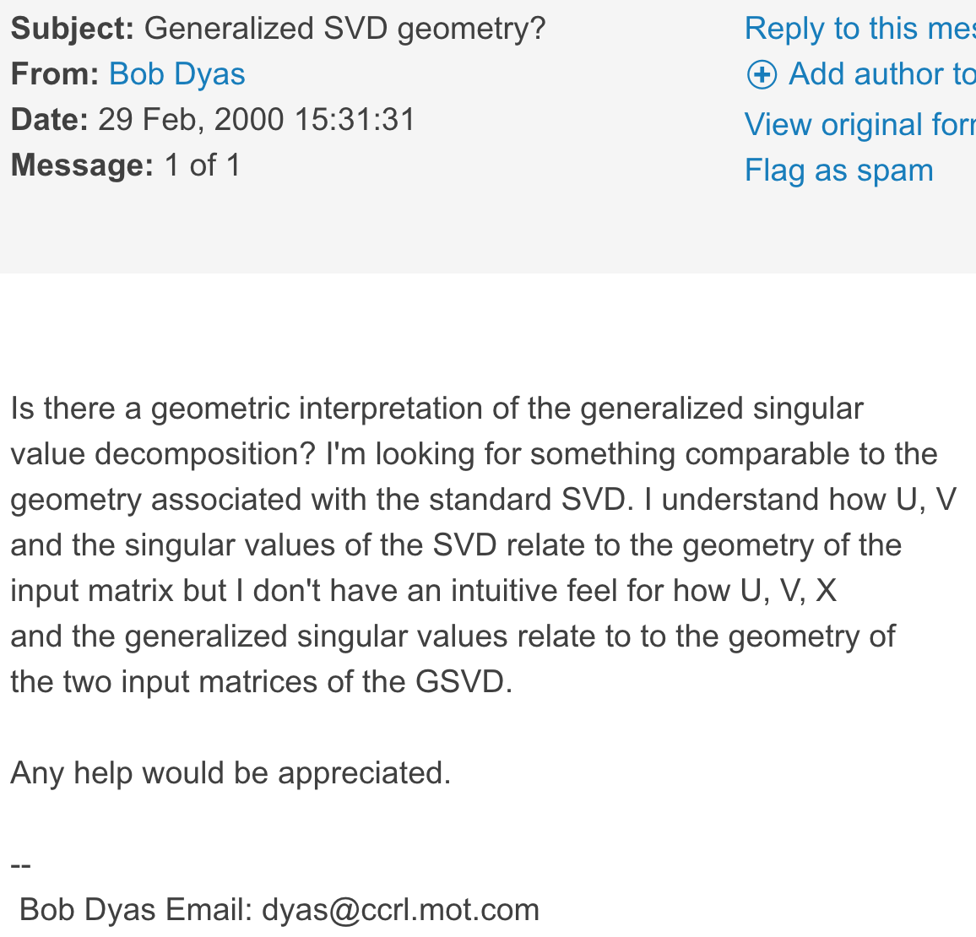
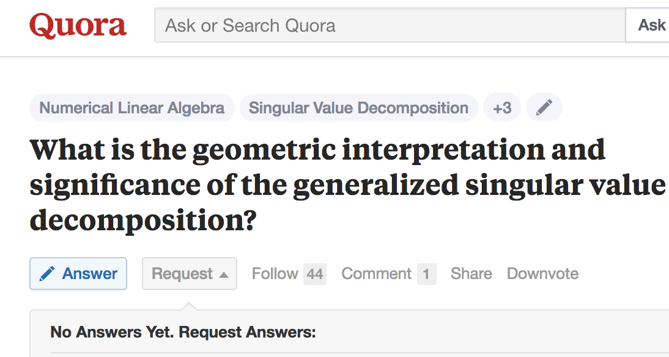
Queries for gsvd geometry:
Indicates no answer in 18 years!
matlabcentral/newsreader/view_thread/15120

Slide 4
I love the GSVD but…
[Van Loan 76’, Paige and Saunders 81, Stewart 82’, Bai 92’]
Assume [A;B] full column rank (otherwise need [H 0])
U, V: square orthogonal
C, S: a bookkeeping nightmare of cosines and sines
H square non-singular, sometimes factored into RQ’ or some variant
Too many matrices!
How dare H not be orthogonal or diagonal, like a proper behaving SVD matrix?
Where are the ellipses?
Notes:
References , now!
Acknowledge people now

Slide 5
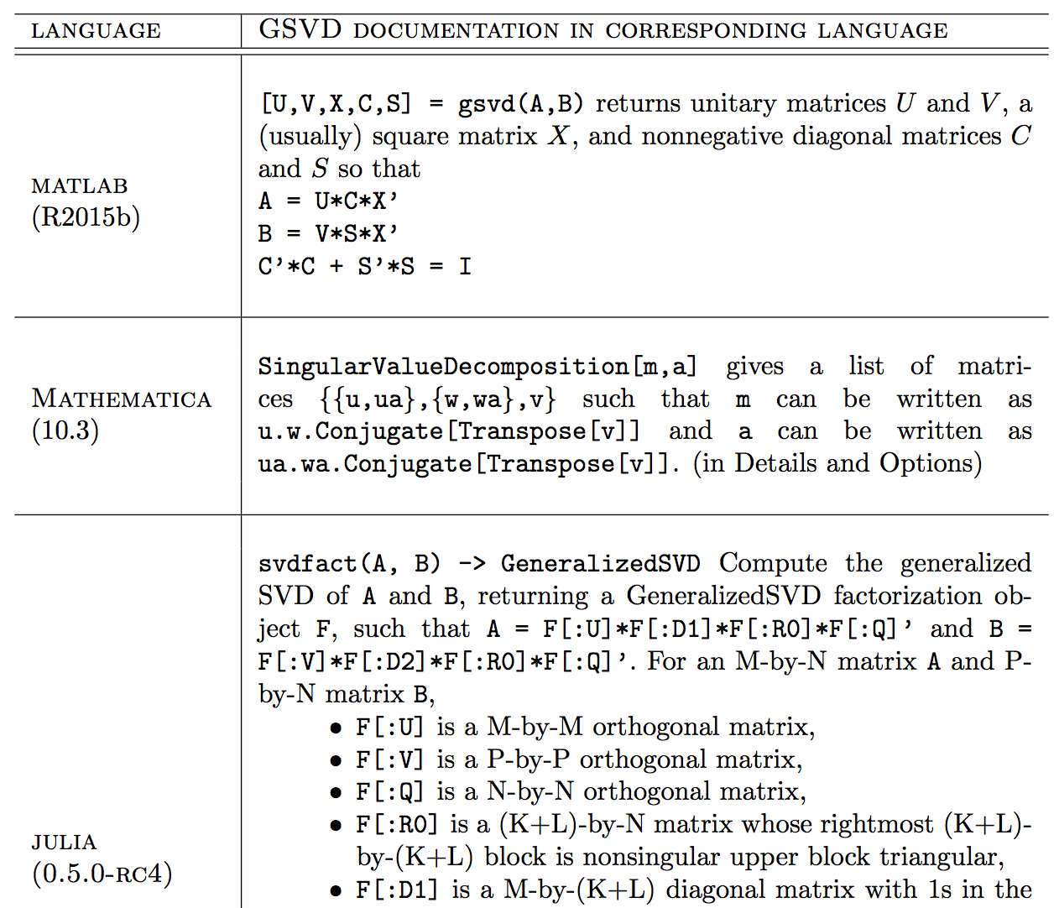
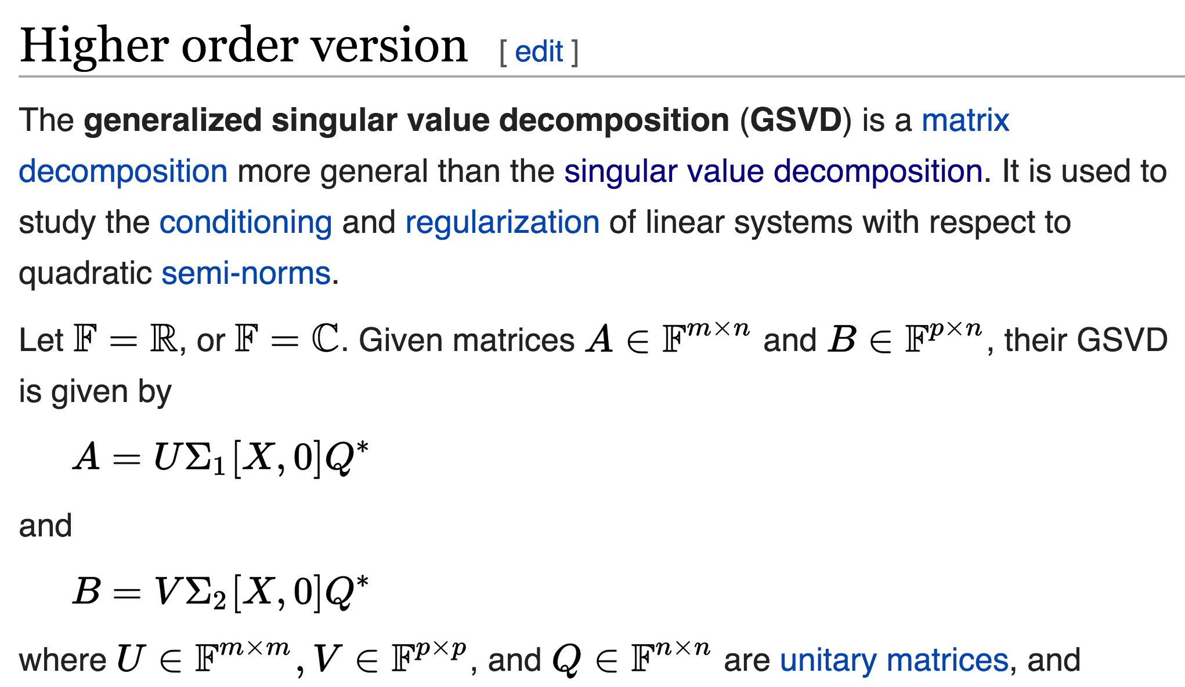
Software Doc
Doesn’t Help
Wikipedia
Doesn’t Help

Slide 6
Picture a 2d plane in 4d with unit circle centered at 0
Y multiaxis
A, B: 2x2
Unit Circle
(Segment)
X multiaxis

Slide 7
Exploded View for Convenience
Y multiaxis
Unit Circle
A, B: 2x2
X multiaxis
X multiaxis

Slide 8
Exploded View for Convenience
Y multiaxis
Unit Circle
Sine Ellipse
A, B: 2x2
“leftward”
projection
“downward”
projection
Cosine Ellipse
X multiaxis

Slide 9
Here are the Ellipses!
Y multiaxis
Unit Circle
Sine Ellipse
A, B: 2x2
“leftward”
projection
“downward”
projection
Cosine Ellipse
X multiaxis

Slide 10
Geometric derivation of the GSVD!
Y multiaxis
Unit Circle
Sine Ellipse
A, B: 2x2
“leftward”
projection
“downward”
projection
Cosine Ellipse
X multiaxis

Slide 11
So far: only depends on span([A;B])
Y multiaxis
Unit Circle
Sine Ellipse
A, B: 2x2
“leftward”
projection
“downward”
projection
Cosine Ellipse
X multiaxis

Slide 12
Hyperplane Position Possibilities
Line in the Plane
Notes:
meaning consider the general position of a hyperplane relative to
multi-axes

Slide 13
Hyperplane Position Possibilities
Plane in R³ :
dim(X)=2 dim(Y)=1 (“X” multiaxis)
Notes:
This is the book

Slide 14
Hyperplane Position Possibilities
Line in R³ :
dim(X)=1 dim(Y)=2 (“Y” multiaxis)

Slide 15
Hyperplane Position Possibilities
Plane in R³ :
dim(X)=1 dim(Y)=2 (“Y” multiaxis)

Slide 16
How to never forget the structure of C and S

Slide 17
n = (n-r_{B} ) + (r_{B}+r_{A}-n) + (n-r_{A} )
A =
m₁ x n
Notes:
If we can animate the bottom moving up and down (and the top in the next slide), we can probably convey a lot
180 degree symmetry
What happens if we interchange A and B? There ought to be some kind of symmetry
With this choice, rot180( C ) = S
If you do make the choice, U is divided with column space on the left, and the left nullspace on the right
V would be the other way …. Which could annoy some people

Slide 18
n = (n-r_{B} ) + (r_{B}+r_{A}-n) + (n-r_{A} )
A =
C =
m₁ x n
m₁ x n
Notes:
If we can animate the bottom moving up and down (and the top in the next slide), we can probably convey a lot
180 degree symmetry
What happens if we interchange A and B? There ought to be some kind of symmetry
With this choice, rot180( C ) = S
If you do make the choice, U is divided with column space on the left, and the left nullspace on the right
V would be the other way …. Which could annoy some people

Slide 19
n = (n-r_{B} ) + (r_{B}+r_{A}-n) + (n-r_{A} )
1
1
1
A =
C =
m₁ x n
m₁ x n
Notes:
If we can animate the bottom moving up and down (and the top in the next slide), we can probably convey a lot
180 degree symmetry
What happens if we interchange A and B? There ought to be some kind of symmetry
With this choice, rot180( C ) = S
If you do make the choice, U is divided with column space on the left, and the left nullspace on the right
V would be the other way …. Which could annoy some people

Slide 20
:Square Matrix
n = (n-r_{B} ) + (r_{B}+r_{A}-n) + (n-r_{A} )
1
1
1
c1
A =
C =
c2
m₁ x n
m₁ x n
1 > c1 ≥ c2 ≥…. > 0
Notes:
If we can animate the bottom moving up and down (and the top in the next slide), we can probably convey a lot
180 degree symmetry
What happens if we interchange A and B? There ought to be some kind of symmetry
With this choice, rot180( C ) = S
If you do make the choice, U is divided with column space on the left, and the left nullspace on the right
V would be the other way …. Which could annoy some people

Slide 21
:Square Matrix
n = (n-r_{B} ) + (r_{B}+r_{A}-n) + (n-r_{A} )
1
1
1
c1
A =
C =
c2
m₁ x n
m₁ x n
0
1 > c1 ≥ c2 ≥…. > 0
Notes:
If we can animate the bottom moving up and down (and the top in the next slide), we can probably convey a lot
180 degree symmetry
What happens if we interchange A and B? There ought to be some kind of symmetry
With this choice, rot180( C ) = S
If you do make the choice, U is divided with column space on the left, and the left nullspace on the right
V would be the other way …. Which could annoy some people

Slide 22
:Square Matrix
n = (n-r_{B} ) + (r_{B}+r_{A}-n) + (n-r_{A} )
1
1
1
c1
A =
C =
c2
m₁ x n
m₁ x n
0
1 > c1 ≥ c2 ≥…. > 0
B =
m₂ x n
Notes:
If we can animate the bottom moving up and down (and the top in the next slide), we can probably convey a lot
180 degree symmetry
What happens if we interchange A and B? There ought to be some kind of symmetry
With this choice, rot180( C ) = S
If you do make the choice, U is divided with column space on the left, and the left nullspace on the right
V would be the other way …. Which could annoy some people

Slide 23
:Square Matrix
n = (n-r_{B} ) + (r_{B}+r_{A}-n) + (n-r_{A} )
1
1
1
c1
A =
C =
c2
m₁ x n
m₁ x n
0
1 > c1 ≥ c2 ≥…. > 0
0 < s1 ≤ s2 ≤ … < 1
0
B =
S =
s1
m₂ x n
m₂ x n
s2
1
1
1
1
Notes:
If we can animate the bottom moving up and down (and the top in the next slide), we can probably convey a lot
180 degree symmetry
What happens if we interchange A and B? There ought to be some kind of symmetry
With this choice, rot180( C ) = S
If you do make the choice, U is divided with column space on the left, and the left nullspace on the right
V would be the other way …. Which could annoy some people

Slide 24
n = (n-r_{B} ) + (r_{B}+r_{A}-n) + (n-r_{A} )
1
1
1
c1
A =
C =
c2
m₁ x n
m₁ x n
0
1 > c1 ≥ c2 ≥…. > 0
0 < s1 ≤ s2 ≤ … < 1
0
B =
S =
s1
m₂ x n
m₂ x n
s2
1
1
1
1
Notes:
If we can animate the bottom moving up and down (and the top in the next slide), we can probably convey a lot
180 degree symmetry
What happens if we interchange A and B? There ought to be some kind of symmetry
With this choice, rot180( C ) = S
If you do make the choice, U is divided with column space on the left, and the left nullspace on the right
V would be the other way …. Which could annoy some people

Slide 25
n = (n-r_{B} ) + (r_{B}+r_{A}-n) + (n-r_{A} )
1
1
1
c1
A =
C =
c2
m₁ x n
m₁ x n
0
0
B =
S =
s1
m₂ x n
m₂ x n
s2
1
1
1
1
Notes:
If we can animate the bottom moving up and down (and the top in the next slide), we can probably convey a lot
180 degree symmetry
What happens if we interchange A and B? There ought to be some kind of symmetry
With this choice, rot180( C ) = S
If you do make the choice, U is divided with column space on the left, and the left nullspace on the right
V would be the other way …. Which could annoy some people

Slide 26
So far: only depends on span([A;B])
Y multiaxis
Unit Circle
Sine Ellipse
A, B: 2x2
“leftward”
projection
“downward”
projection
Cosine Ellipse
X multiaxis

Slide 27
GSVD Jacobian: Grassmanian
The Players
The Differential

Slide 28
GSVD Jacobian
The Differential
Diagonal
Anti-symmetric
Rectangle
Rectangle
Notes:
\color[rgb]{0.098039,0.160784,0.317647}
\color[rgb]{0.000000,0.458647,0.000000}(U^{\perp})^{T}\rmd UC
\color[rgb]{1.000000,0.740823,0.000000}(V^{\perp})^{T}\rmd VS

Slide 29
GSVD Jacobian
Diagonal
Diagonal
Anti-symmetric
Rectangle
Rectangle
Notes:
\color[rgb]{0.098039,0.160784,0.317647}
\color[rgb]{0.000000,0.458647,0.000000}(U^{\perp})^{T}\rmd UC
\color[rgb]{1.000000,0.740823,0.000000}(V^{\perp})^{T}\rmd VS

Slide 30
GSVD Jacobian
Anti-symmetric (Only for )
Diagonal
Anti-symmetric
Rectangle
Rectangle
Notes:
\color[rgb]{0.098039,0.160784,0.317647}
\color[rgb]{0.000000,0.458647,0.000000}(U^{\perp})^{T}\rmd UC
\color[rgb]{1.000000,0.740823,0.000000}(V^{\perp})^{T}\rmd VS

Slide 31
GSVD Jacobian
Rectangle
Diagonal
Anti-symmetric
Rectangle
Rectangle
Notes:
\color[rgb]{0.098039,0.160784,0.317647}
\color[rgb]{0.000000,0.458647,0.000000}(U^{\perp})^{T}\rmd UC
\color[rgb]{1.000000,0.740823,0.000000}(V^{\perp})^{T}\rmd VS

Slide 32
GSVD Jacobian
Rectangle
Diagonal
Anti-symmetric
Rectangle
Rectangle
Notes:
\color[rgb]{0.098039,0.160784,0.317647}
\color[rgb]{0.000000,0.458647,0.000000}(U^{\perp})^{T}\rmd UC
\color[rgb]{1.000000,0.740823,0.000000}(V^{\perp})^{T}\rmd VS

Slide 33
GSVD Jacobian
Diagonal
Anti-symmetric
Rectangle
Rectangle
Notes:
\color[rgb]{0.098039,0.160784,0.317647}
\color[rgb]{0.000000,0.458647,0.000000}(U^{\perp})^{T}\rmd UC
\color[rgb]{1.000000,0.740823,0.000000}(V^{\perp})^{T}\rmd VS

Slide 34
H connects the two bases
  span of [A;B] = span of [UC;VS]
  [A;B] = [UC;VS]H
  Any basis = (natural geometric basis) * H

Slide 35
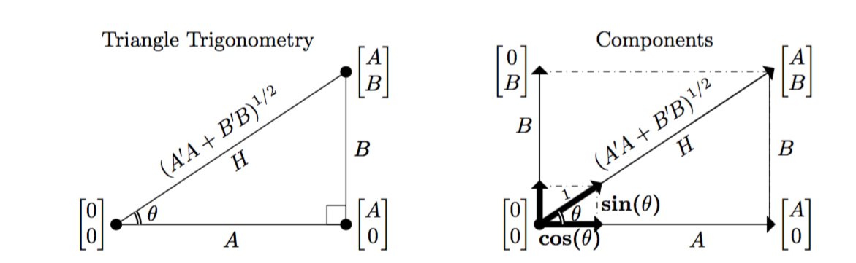
Matrix Trigonometry
Notes:
But which H
?

Slide 36
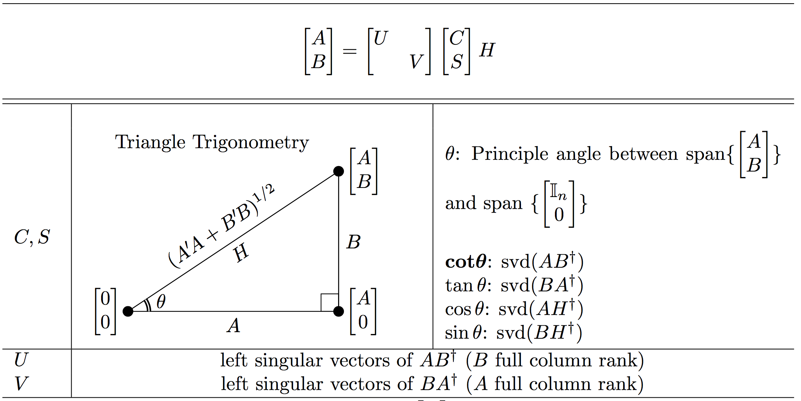
Matrix Trigonometry

Slide 37
GSVD as a Multislope
graph of line
slope b/a
graph of hyperplane
multislope = gsvd(B,A)
Multislope = tangents of multi-angles with Horizontal MultiAxis
Notes:
{at;bt}:all scalars t} = graph of line
slope b/a
{[At;Bt] : all vectors t} = graph of hyperplane
multislope = gsvd(B,A)
Multislope = tangents of multi-angles with Horizontal MultiAxis
Useful to compare “how much” A to “how much” B
Heads Up: Nothing to do with angles between A and B

Slide 38
GSVD as a Multislope
graph of line
slope b/a
graph of hyperplane
multislope = gsvd(B,A)
Nothing to do with angles between A and B
Notes:
{at;bt}:all scalars t} = graph of line
slope b/a
{[At;Bt] : all vectors t} = graph of hyperplane
multislope = gsvd(B,A)
Multislope = tangents of multi-angles with Horizontal MultiAxis
Useful to compare “how much” A to “how much” B

Slide 39
It would have been nice if…
?
What’s the catch?
A=[3 0;0 4] B=[1 1]
svd (A*pinv(B) ) = 2.5
gsvd (A,B) = 2.4, Inf

Slide 40
Theorem 1
P is the projection onto the orthogonal complement of
A=[3 0;0 4] B=[1 1]
svd (P*A*pinv(B) ) = 2.4
gsvd (A,B) = 2.4, Inf
Let N=[1;-1] (nullspace of B)
Let P = projection onto A*N = [.64 .48;.48 .36]
Notes:
Theorem: Let [A;B] have full column rank. Then the finite generalized singular values of (A,B) are the singular values of P*A*pinv(B), where P is the projection onto the orthogonal complement of A*nullspace(B).
Remark: If B has full column rank, then nullspace(B)=0, and P=I so A*pinv(B) works.
Remark: This theorem allows the use of any basis N for the nullspace(B). P is then projection onto the left nullspace of A*N. One choice of N is X[:,r-rB+1:end] from the GSVD, but one can use QR, the SVD, etc.
Remark: Finite means non-zero and non-infinite.
Example:

Slide 41
Theorem 2
Matrices with Full Column Rank
B(t)
B
A(t)
A

Slide 42
Theorem 2
Okay to augment rows to make theorem work
gsvd( , ) = 2.4 and ∞
gsvd( , ) = 2.4 + O(ε²), 5/ε + O(ε)

Slide 43
Theorem 3
is with 0 singular values replaced with
  Find a perturbation series for the singular values

Slide 44
Watching Convergence as a Perturbation Series
  Find a perturbation series for the singular values:
  Infinite Singular Value Perturbation Series:
  Finite Singular Value Perturbation Series: (feels )

Slide 45
Second Derivative of the SVD
Square, diagonal

Slide 46
From Least-squares to
Tikhonov Regularization
What’s its geometric interpretation?

Slide 47
Tikhonov Regularization
Parameters:
cosine x hypotenuse = c

Slide 48
Tikhonov Regularization
Parameters:
(A full column rank)
(any will do )
cosine x hypotenuse = constant =
=

Slide 49
Tikhonov Regularization
Parameters:
(A full column rank)
(any will do )
cosine x hypotenuse = constant =
=
Two cosines:
Projection of b
Hypotenuse

Slide 50
Tikhonov Regularization
Parameters:
(A full column rank)
(any will do )
cosine x hypotenuse = constant =
=
Two cosines:
Projection of b
Hypotenuse
In English: in a geometric basis,
regularization controls
growth by contracting by
in each [u_{i};0],[0;v_{i}] plane.
usually we see only c¹ in the
numerator H₀ is scale independent.

Slide 51
Tikhonov Regularization
Parameters:
(A full column rank)
(any will do )
cosine x hypotenuse = constant =
=
Also note commute.
Two cosines:
Projection of b
Hypotenuse
In English: in a geometric basis,
regularization controls
growth by contracting by
in each [u_{i};0],[0;v_{i}] plane.
usually we see only c¹ in the
numerator H₀ is scale independent.

Slide 52
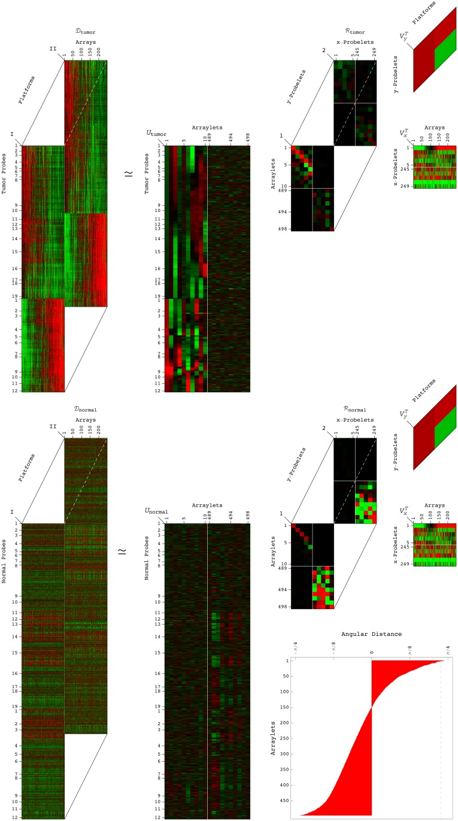
Applications
Biomedical research (Alter et. al.,
Signal processing
Many more to come …

Slide 53
You may have seen some of….
Motivation
Geometrical Construction
How to never forget C and S
Julia Demo Notebook
Geometric Examples
Grassmann Differential Geometry as used in Stats
Three GSVD Theorems
Application to Tikhonov Regularization

Slide 54
Determines whether h_{i}
(the ith row of the rowspace basis)
is primarily attributable to
A, B or a mixture.
All B
:
Y
Mostly B
Equally A,B
= possible
location of
[ u_{i}c_{i}; v_{i}s_{i} ]
Unit Sphere
Mostly A
Hyperplane
= Span([A;B])
X
All A

