Slide 1



Singular Values of the GUE
Surprises that we Missed
Alan Edelman and Michael LaCroix
MIT
June 16, 2014
(acknowledging gratefully the help from Bernie Wang)

Slide 2
GUE Quiz
GUE Eigenvalue Probability Density (up to scalings)
β=2 Repulsion Term
and repel?
Do the singular values and repel?
Do the eigenvalues
When n = 2

Slide 3
GUE Quiz
Do the eigenvalues repel?
  Yes of course

Slide 4
GUE Quiz
Do the eigenvalues repel?
  Yes of course
Do the singular values repel?
  No, surprisingly they do not.
  Guess what? they are independent

Slide 5
GUE Quiz
Do the eigenvalues repel?
  Yes of course
Do the singular values repel?
  No, surprisingly they do not.
  Guess what? they are independent
  The GUE was introduced by Dyson in 1962, has been well studied for 50+ years, and this simple fact seems not to have been noticed.

Slide 6
GUE Quiz
Do the eigenvalues repel?
  Yes of course
Do the singular values repel?
  No, surprisingly they do not.
  Guess what? they are independent
  The GUE was introduced by Dyson in 1962, has been well studied for 50+ years, and this simple fact seems not to have been noticed.
  When n=2: the GUE singular values are independent and
  Perhaps just a special small case? That happens.

Slide 7
The Main Theorem
The singular values of an n x n GUE(matrix) are the “mixing” of the singular values of two independent Laguerre ensembles
… with some ½ integer dimensions!!
  n x n GUE = (n-1)/2 x n/2 LUE Union (n+1)/2 x n/2 LUE
  singular value count: add the integers
    n even: n=n/2 + n/2 n odd: n=(n-1)/2 + (n+1)/2

Slide 8
The Main Theorem
The singular values of an n x n GUE(matrix) are the “mixing” of the singular values of two Laguerre ensembles
Level Density Illustration
16 x 16 GUE = 8.5 x 8 LUE union 7.5 x 8 LUE
- (GUE)
tridiagonal models
(LUEs)
bidiagonal models

Slide 9
How could this have been missed?
Non-integer sizes:
  n x (n+1/2) and n by (n-1/2) matrices boggle the imagination
  Dumitriu and Forrester (2010) came “part of the way”
Singular Values vs Eigenvalues:
  have not enjoyed equal rights in mathematics until recent history (Laguerre ensembles are SVD ensembles)
  it feels like we are throwing away the sign, but “less is more”
Non pretty densities
  density: sum over 2^n choices of sign on the eigenvalues
  characterization: mixture of random variables

Slide 10
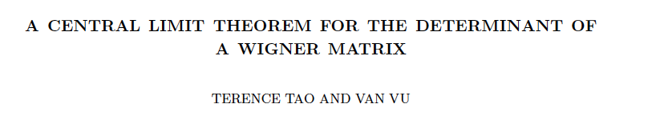
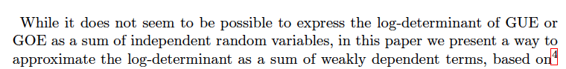
Tao-Vu (2012)

Slide 11
Tao-Vu (2012)
GUE
Independent

Slide 12
Tao-Vu (2012)
GUE
Independent
GOE, GSE, etc. …. nothing we can say ☺

Slide 13
Laguerre Models Reminder
reminder for β=2
Exponent α:
or when β=2, α=
bottom right of Laguerre:
  when β=2, it is 2*(α+1)
  when α=1/2, bottom right is 3
  when α=-1/2 bottom right is 1

Slide 14
Laguerre Models
Done the Other Way
Householder (by rows)
Householder (by columns)

Slide 15
GUE Building Blocks
Build Structure from bottom right
GUE(n) = Union of singular values of two consecutive structures

Slide 16
GUE Building Blocks
Build Structure from bottom right
GUE(n) = Union of singular values of two consecutive structures
1x1 (n=1, n=2)
Next
NULL
Previous
0x1 (n=1)

Slide 17
GUE Building Blocks
Build Structure from bottom right
GUE(n) = Union of singular values of two consecutive structures
1x2 (n=2, n=3)
Next
0 x 1 (n=0, n=1)
Previous
1x1 (n=1, n=2)

Slide 18
Build Structure from bottom right
GUE(n) = Union of singular values of two consecutive structures
GUE Building Blocks
2x2 (n=3, n=4)
Next
1x1 (n=1, n=2)
Previous
2x1 (n=2, n=3)

Slide 19
GUE Building Blocks
Build Structure from bottom right
GUE(n) = Union of singular values of two consecutive structures
2x3 (n=4, n=5)
Next
1 x 2 (n=2, n=3)
Previous
2x2 (n=3, n=4)

Slide 20
GUE Building Blocks
Build Structure from bottom right
GUE(n) = Union of singular values of two consecutive structures
3x3 (n=5, n=6)
Next
2 x 2 (n=3, n=4)
Previous
2x3 (n=4, n=5)

Slide 21
GUE Building Blocks
Build Structure from bottom right
GUE(n) = Union of singular values of two consecutive structures
3x4 (n=6, n=7)
Next
2 x 3 (n=4, n=5)
Previous
3x3 (n=5, n=6)

Slide 22
GUE Building Blocks
Build Structure from bottom right
GUE(n) = Union of singular values of two consecutive structures
4x4 (n=7, n=8)
Next
3 x 3 (n=5, n=6)
Previous
3x4 (n=6, n=7)

Slide 23
Build Structure from bottom right
GUE(n) = Union of singular values of two consecutive structures
GUE Building Blocks
4x5 (n=8, n=9)
Next
3 x 4 (n=6, n=7)
Previous
4x4 (n=7, n=8)

Slide 24
GUE Building Blocks
Build Structure from bottom right
GUE(n) = Union of singular values of two consecutive structures
5x5 (n=9, n=10)
Next
4 x 4 (n=7, n=8)
Previous
4x5 (n=8, n=9)

Slide 25
GUE Building Blocks
Build Structure from bottom right
GUE(n) = Union of singular values of two consecutive structures
5x6 (n=10, n=11)
Next
4 x 5 (n=8, n=9)
Previous
5x5 (n=9, n=10)

Slide 26
GUE Building Blocks
Build Structure from bottom right
GUE(n) = Union of singular values of two consecutive structures
5 x 5 (n=9, n=10)
Previous
5x6 (n=10, n=11)

Slide 27
GUE Building Blocks
Exactly a Laguerre -1/2 model
Equivalent to a Laguerre +1/2 model
Square Laguerre
but missing a number
Square Matrices
One More Column than Rows
10 x 10 GUE
9 x 9 GUE
8 x 8 GUE
7 x 7 GUE
6 x 6 GUE
5 x 5 GUE
4 x 4 GUE
3 x 3 GUE
2 x 2 GUE
1 x 1 GUE
[0 x 1]

Slide 28


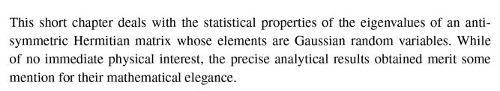
Anti-symmetric ensembles: the irony!

Slide 29
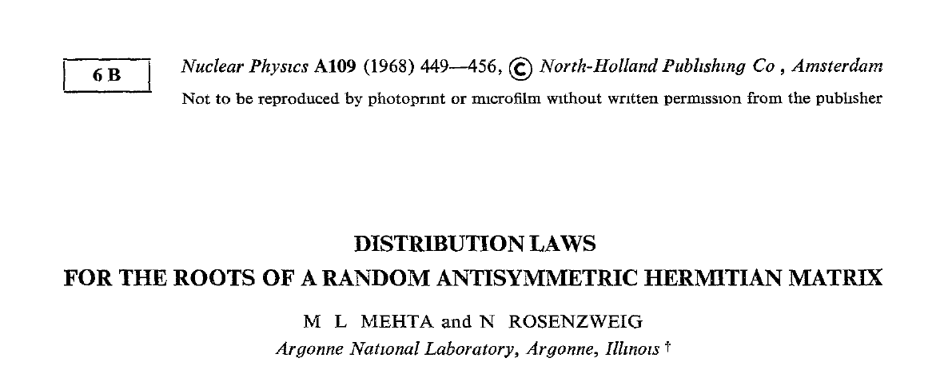
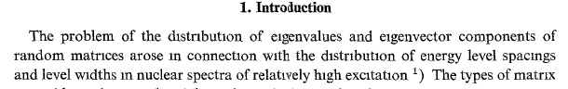
Anti-symmetric ensembles: the irony!

Slide 30
Anti-symmetric ensembles: the irony!
Guess what?
Turns out the anti-symmetric
ensembles encode the very
gap probabilities they were
studying!

Slide 31
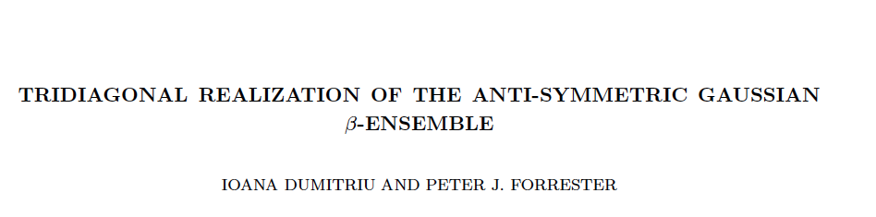
Antisymmetric Ensembles
Thanks to Dumitriu, Forrester (2009):
  Unitary Antisymmetric Ensembles equivalent to Laguerre Ensembles with α = +1/2 or -1/2 (alternating)
really a bidiagonal realization

Slide 32
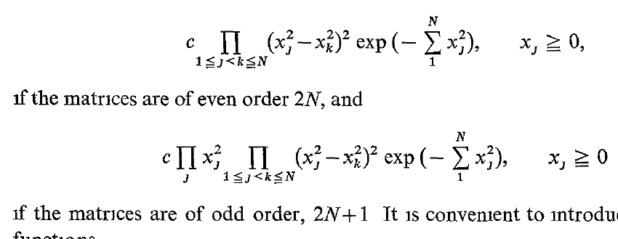
Antisymmetric Ensembles
DF: Take bidiagonal B, turn it into an antisymmetric:
Then “un-shuffle” permute to an antisymmetric tridiagonal which could have been obtained by Householder reduction.
Our results therefore say that the eigenvalues of the GUE are a combination of the unique singular values of two antisymmetrics.
In particular the gap probability!

Slide 33
Fredholm Determinant Formulation
  GUE has no eigenvalues in [-s,s]
  GUE has no singular values in [0,s]
  LUE (-1/2) has no eigenvalues in [0,s^2]
  LUE (-1/2) has no singular values in[0,s]
  LUE(+ 1/2) has no eigenvalues in [0,s^2]
  LUE (+1/2) has no singular values in[0,s]
The Probability of No GUE Singular Value in [0,s] =
The Probability of no LUE(-1/2) Singular Value in [0,s] *
The Probability of no LUE(1/2) Singular Value in [0,s]

Slide 34
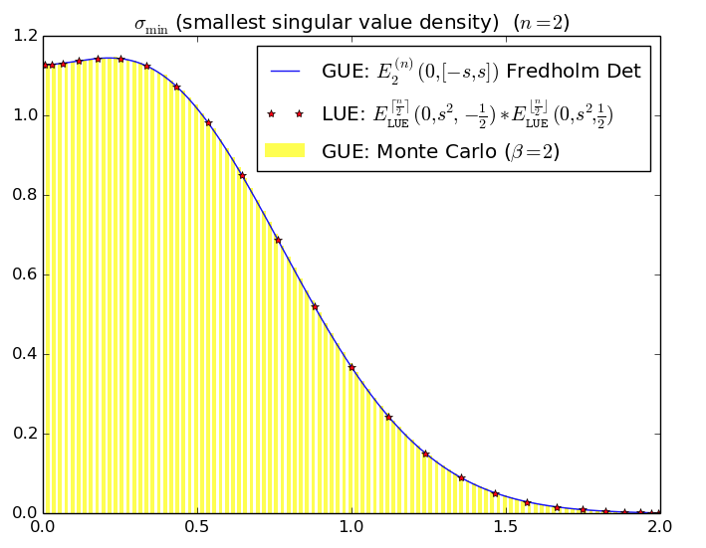
Numerical Verification
Bornemann Toolbox:

Slide 35
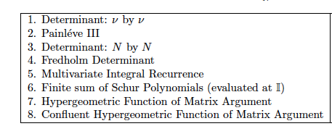
Laguerre smallest sv potential formulas
Shows that many of these formulations are not powerful enough to understand
ν by ν determinants when ν is not a positive integer
especially when +1/2 and -1/2 is otherwise so natural
(More in upcoming paper with Guionnet and Péché)

Slide 36
Hermite = Laguerre + Laguerre
GUE Level Density
Laguerre Singular
Value density
=
+

Slide 37
Hermite = Laguerre + Laguerre
  Proof 1: Use the famous Hermite/Laguerre equality
  Proof 2: a random singular value of the GUE is a random singular value of (+1/2) or (-1/2) LUE
=
+

Slide 38
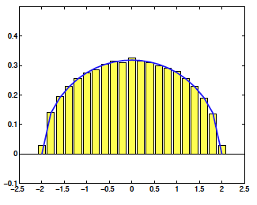
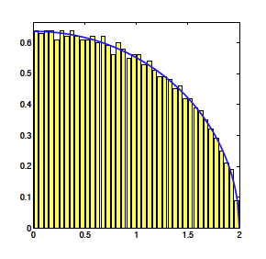
|Semicircle|
= QuarterCircle + QuarterCircle
=
+
Random Variables: “Union”
Densities: Fold and normalize

Slide 39
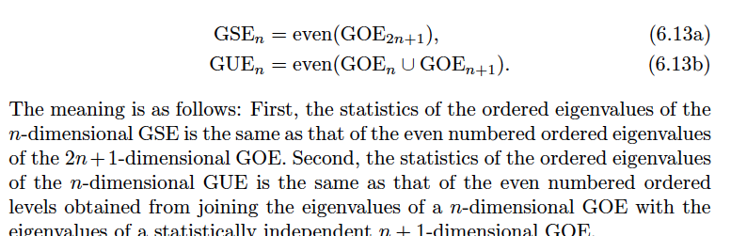
Forrester Rains downdating
Sounds similar
but is different
concerns ordered eigenvalues

Slide 40
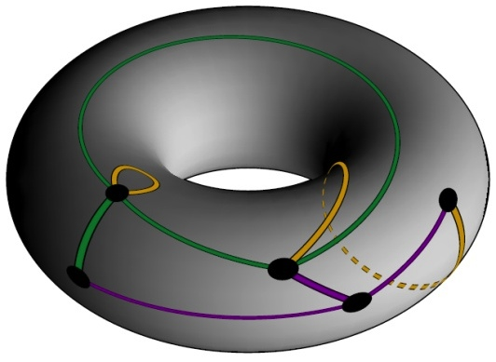
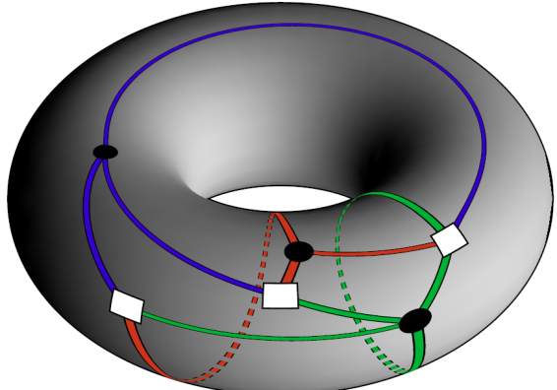
(Selberg Integrals and)
Combinatorics of mult polynomials:
Graphs on Surfaces
(Thanks to Mike LaCroix)
Hermite: Maps with one Vertex Coloring
Laguerre: Bipartite Maps with multiple Vertex Colorings
Jacobi: We know it’s there, but don’t have it quite yet.

Slide 41
A Hard Edge for GUE
LUE and JUE each have hard edges
We argue that the smallest singular value of the GUE is a kind of overlooked hard edge as well

Slide 42
Proof Outline
Let be the GUE eigenvalue density
The singular value density is then
“An image in each n-dimensional quadrant”

Slide 43
Proof Outline
Let and
be LUE svd densities
The mixed density is
where the sum is taken over the
partitions of 1:n into parts of size

Slide 44
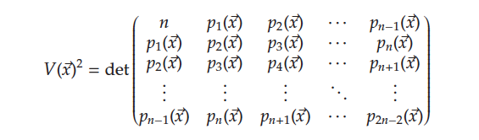
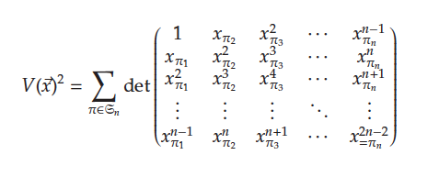
Vandermonde Determinant
Sum n^{n} determinants, only permutations remain

Slide 45
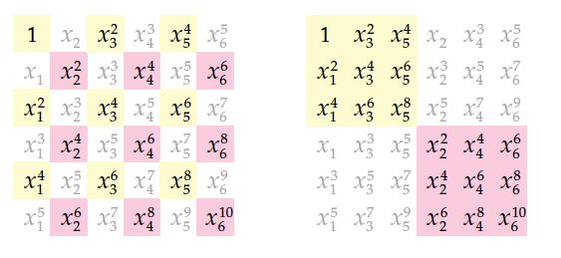
shuffle
unshuffle

Slide 46
Proof
When adding ±, gray entries vanish.
→ Product of detrminants
Correspond to LUE SVD densities
One term for each choice of splitting

Slide 47
Conclusion and Moral
As you probably know, just when you think everything about a field is already known, there always seems to be surprises that have been missed
Applications can be made to condition number distributions of GUE matrices
Any general beta versions to be found?

