Slide 1


On an Integral Geometry Inspired Method for Conditional Sampling from Gaussian Ensembles
Alan Edelman
Oren Mangoubi, Bernie Wang
Mathematics
Computer Science & AI Labs
January 13, 2014

Slide 2
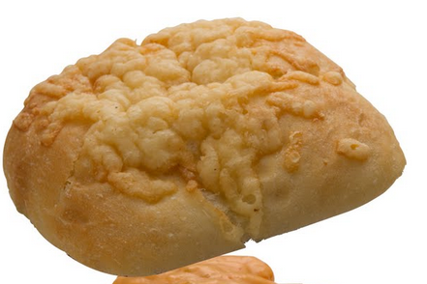
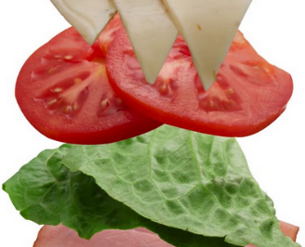
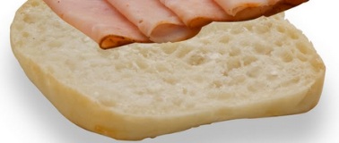

Talk Sandwich
Stories ``Lost and Found”: Random Matrices in the years 1955-1965
Integral Geometry Inspired Method for Conditional Sampling from Gaussian Ensembles
Demo: On the higher order correction of the distribution of the smallest singular value

Slide 3
Stories “Lost and Found”
Random Matrices in the Years
1955-1965

Slide 4
Lost and Found
Wigner thanks Narayana
  Ironically, Narayana (1930-1987) probably never knew that his polynomials are the moments for Laguerre (Catalan:Hermite :: Narayana:Laguerre)
The statistics/physics links were severed
  Wigner knew Wishart matrices
  Even dubbed the GOE ``the Wishart set’’
Numerical Simulation was common (starting 1958)
  Art of simulation seems lost for many decades and then refound

Slide 5
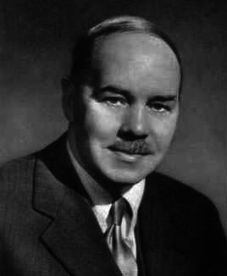
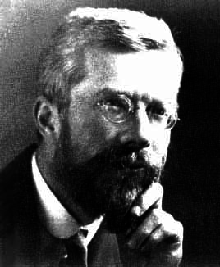
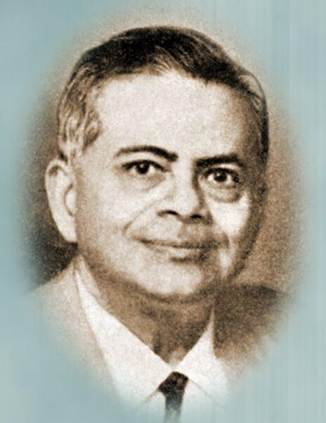
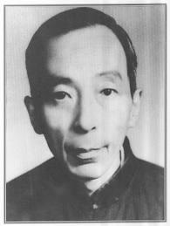
In the beginning…
Statisticians found the
Laguerre and Jacobi Ensembles
John Wishart
1898-1956
Sir Ronald Alymer Fisher
1890-1962
Samarendra Nath Roy
1906-1964
Pao-Lu Hsu
1909-1970
Joint Element density
Joint Eigenvalue Densities:
real Laguerre and Jacobi Ensembles 1939 etc.

Slide 6
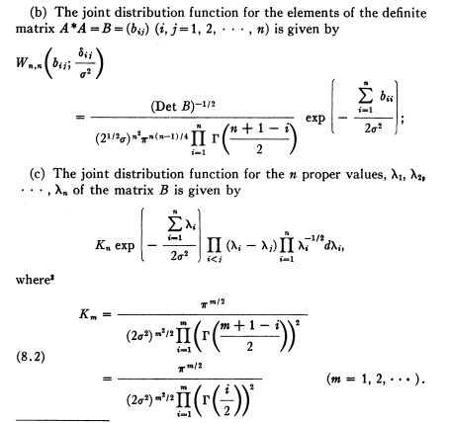
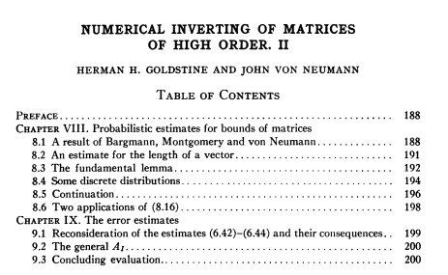
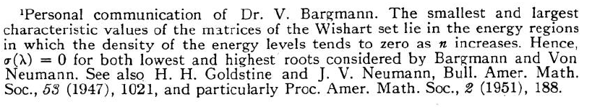
1951: Bargmann, Von Neumann carry the “Wishart torch” to Princeton
[Goldstine and Von Neumann, 1951]
Statistical Properties of Real Symmetric Matrices with Many Dimensions
[Wigner, 1957]

Slide 7
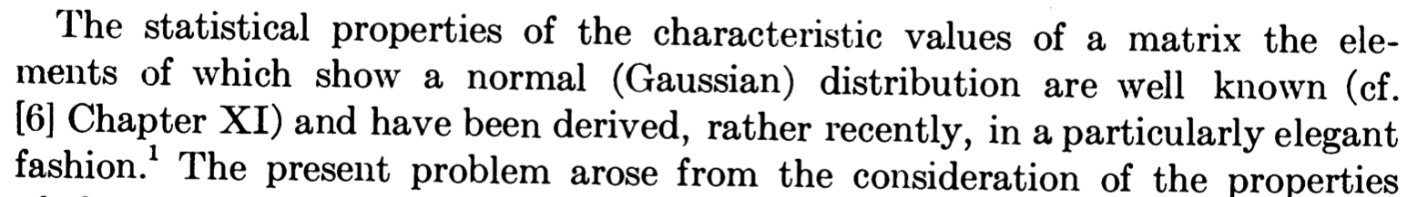
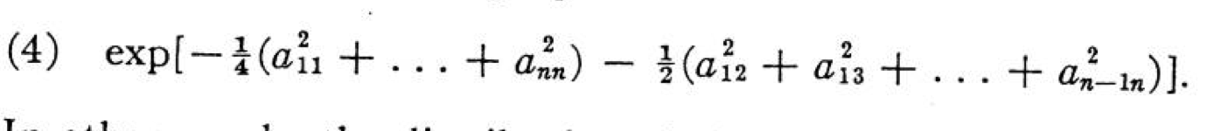
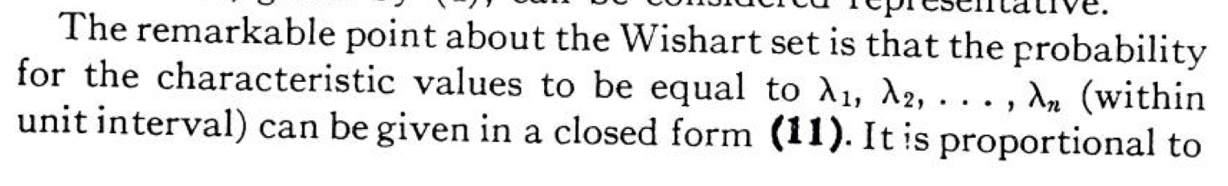
Wigner referencing Wishart
1955-1957
[Wigner, 1955]
GOE
[Wigner, 1957]

Slide 8
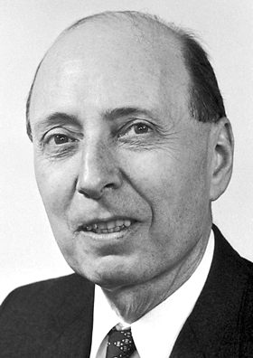
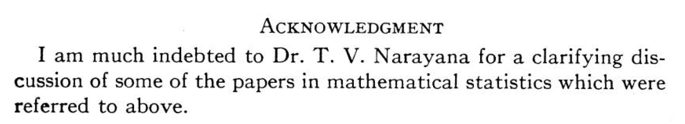
Wigner and Narayana
Photo
Unavailable
[Wigner, 1957]
(Narayana was 27)
Marcenko-Pastur = Limiting Density for Laguerre
Moments are Narayana Polynomials!
Narayana probably would not have known

Slide 9
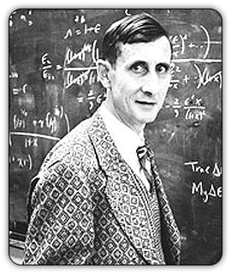
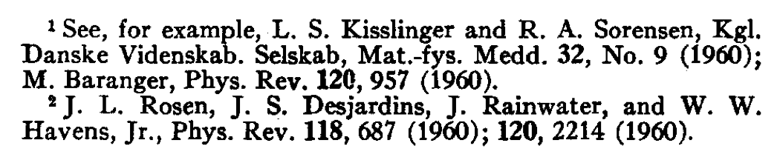
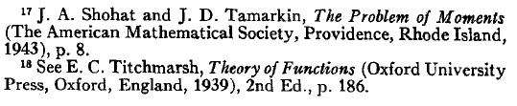
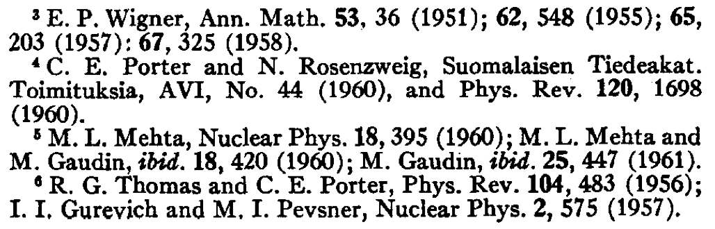
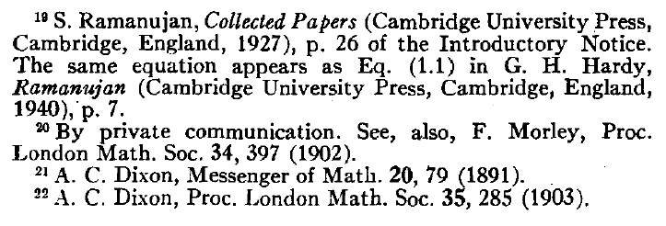
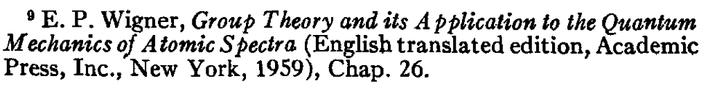
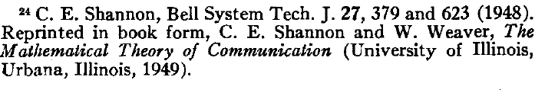

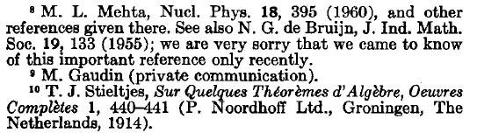

Dyson (unlike Wigner) not concerned with statisticians
Papers concern β =1,2,4 Hermite
(lost touch with Laguerre and Jacobi)
Terms like Wishart, MANOVA, Gaussian Ensembles probably severed ties
Hermite, Laguerre, Jacobi unify

Slide 10
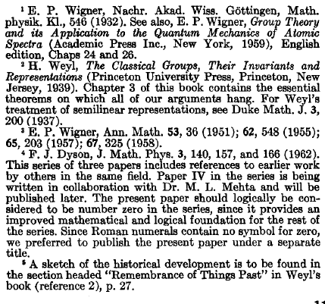
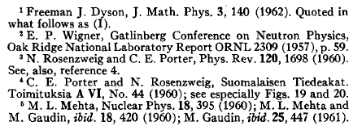




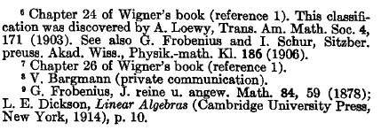

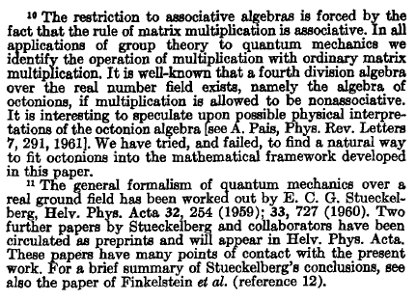


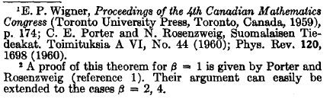
Dyson’s Needle in the Haystack
“needle in the haystack”

Slide 11
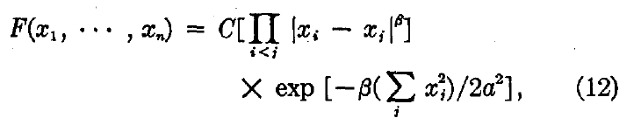
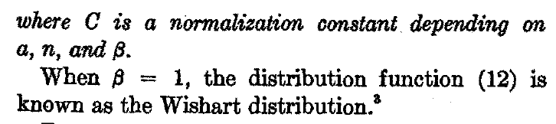
Dyson’s: Wishart Reference
(We’d call it GOE)
[Dyson, 1962]
Dyson Brownian Motion

Slide 12
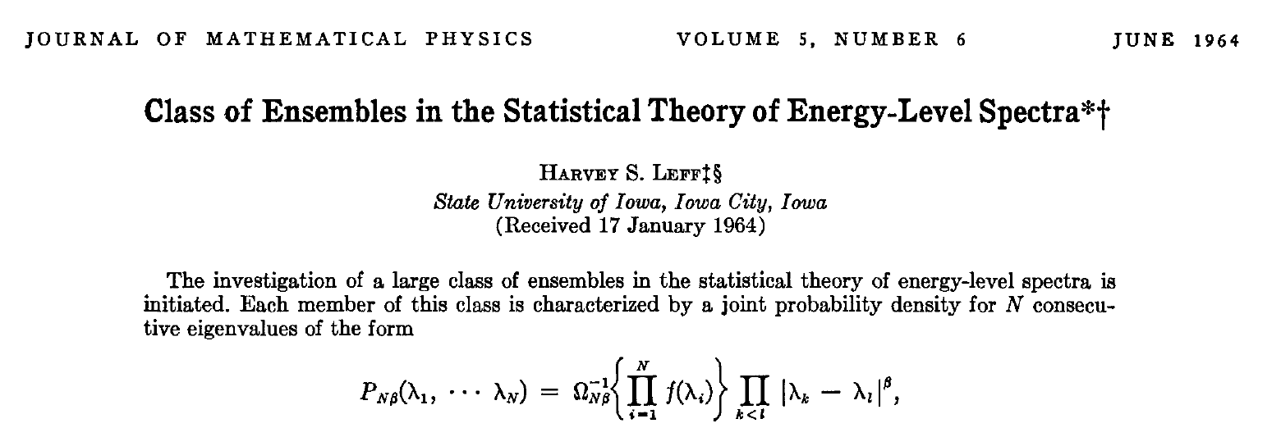
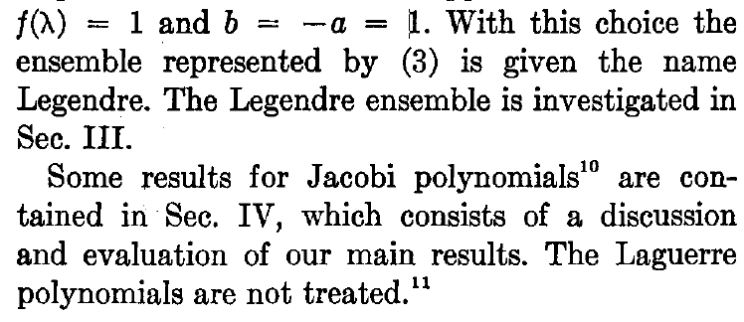
1964: Harvey Leff

Slide 13
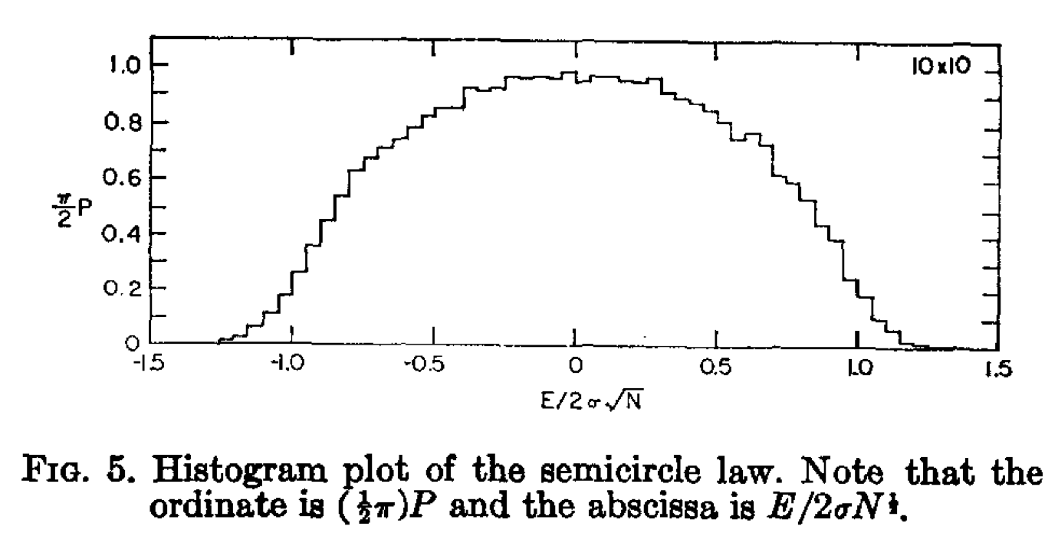
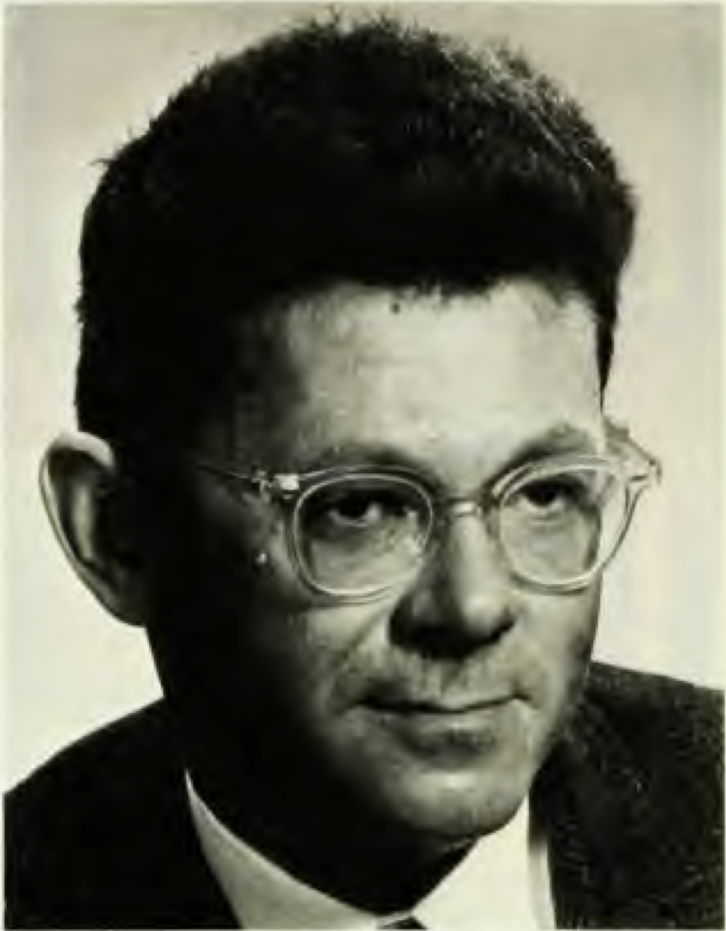
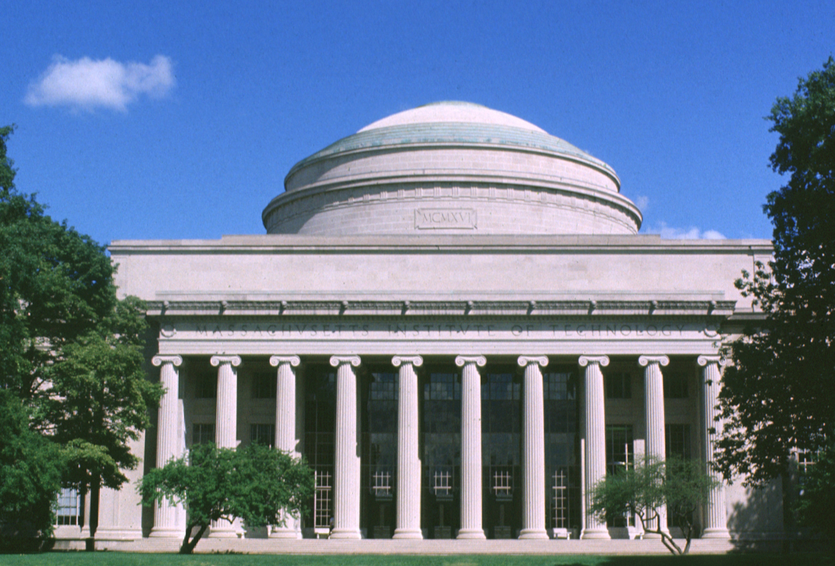
RMT Monte Carlo Computation goes Way Back
First Semi-circle plot (GOE)
By
Porter and Rosenzweig, 1960
Later Semicircle plot
By
Porter, 1963
Photo
Unavailable
Charles Porter,
(1927-1964)
PhD MIT 1953
(Los Alamos,
Brookhaven National Laboratory )
Norbert Rosenzweig
(1925-1977)
PhD Cornell 1951
(Argonne National Lab)

Slide 14
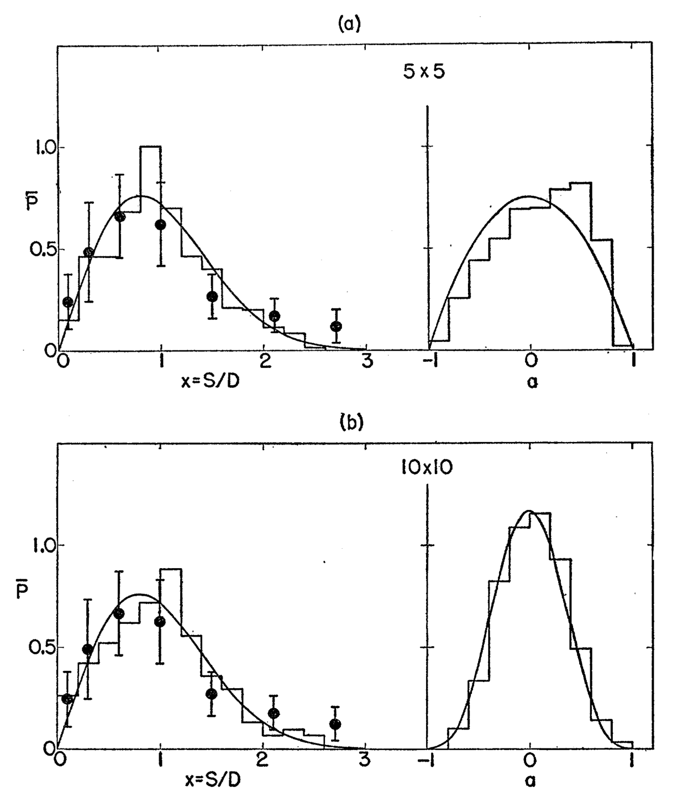
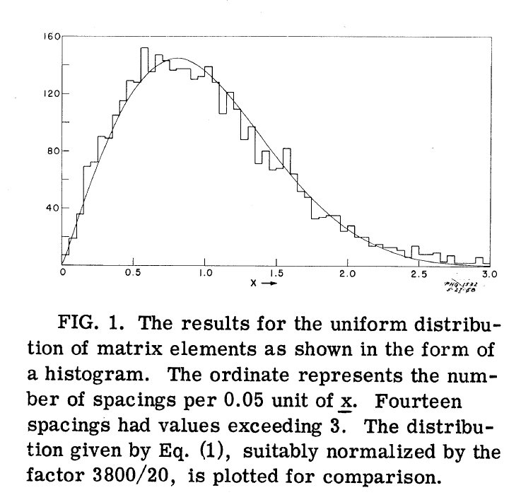
First MC Experiments (1958)
[Rosenzweig, 1958]
[Blumberg and Porter, 1958]

Slide 15
Early Computations: especially level density & spacings
Computer | Year | Facility | FLOPS | Reference
GEORGE | 1957 | Argonne | ? | (Rosenzweig, 1958)
IBM 704 | 1954 | Los Alamos Argonne | 12k | (Blumberg and Porter, 1958) (Porter and Rosenzweig, 1960)
IBM 7090 | 1959 | Brookhaven | 100k | (Porter et al., 1963)
Figure | n | # matrices | Spacings= # x (n-1) | Eigenvector Components = # x n^2
14 | 2 | 966 | 966 x 1 = 966 | 966 x 4 = 3,864
15 | 3 | 5117 | 5117 x 2 = 10,234 | 5117 x 9 = 46,053
16 | 4 | 1018 | 1018 x 3 = 3,054 | 1018 x 16 = 16,288
17 | 5 | 1573 | 1573 x 4 = 6,292 | 1573 x 25 = 39,325
18 | 10 | 108 | 108 x 9 = 972 | 108 x 100 = 10,800
19,20,21 | 20 | 181 | 181 x 11 = 1991 | N/A
22 | 40 | 1 | 1 x 39 = 39 | N/A
[Porter and Rosenzweig, 1960]

Slide 16

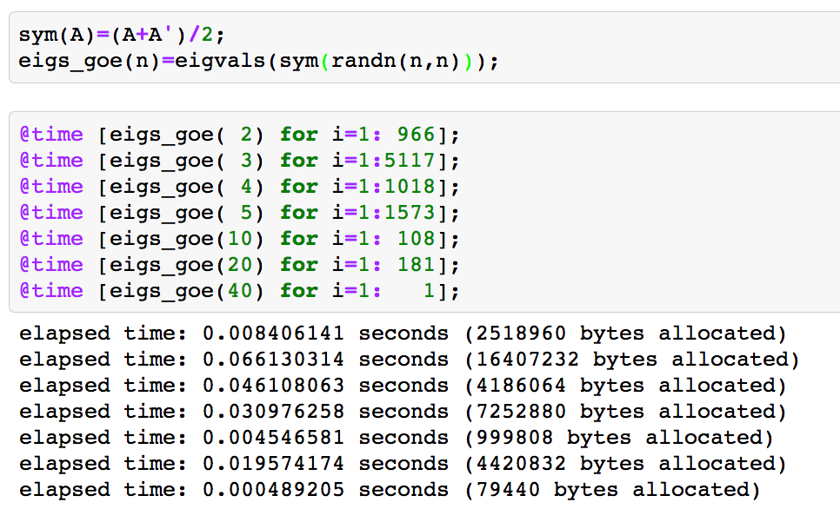
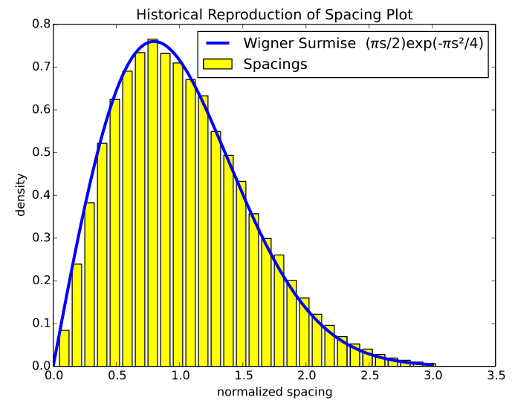
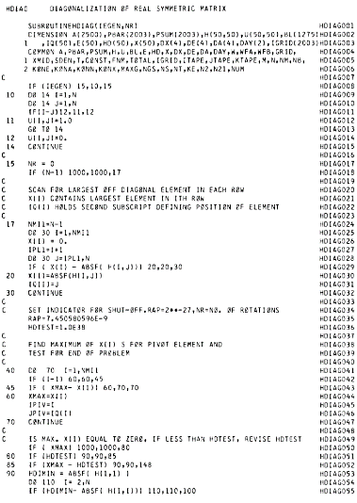
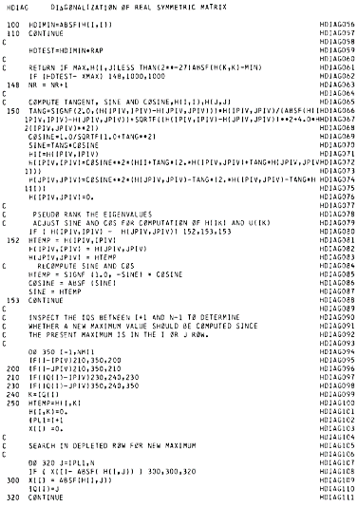
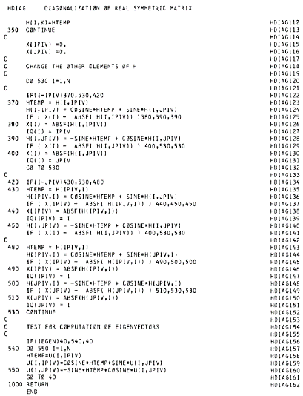
More Modern Spacing Plot
5000 60 x 60 matrices

Slide 17
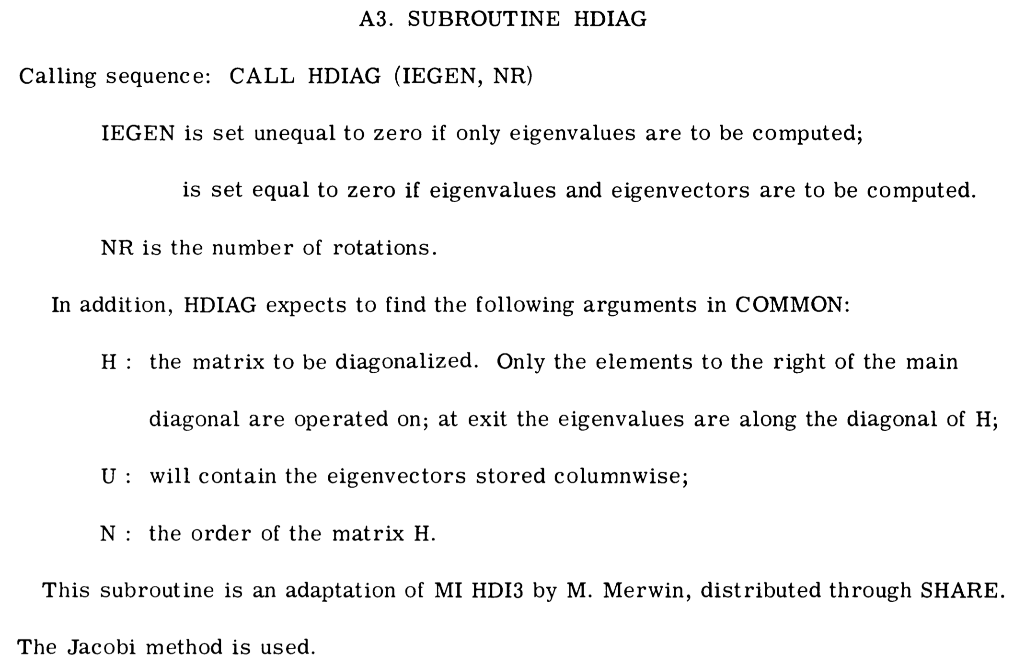
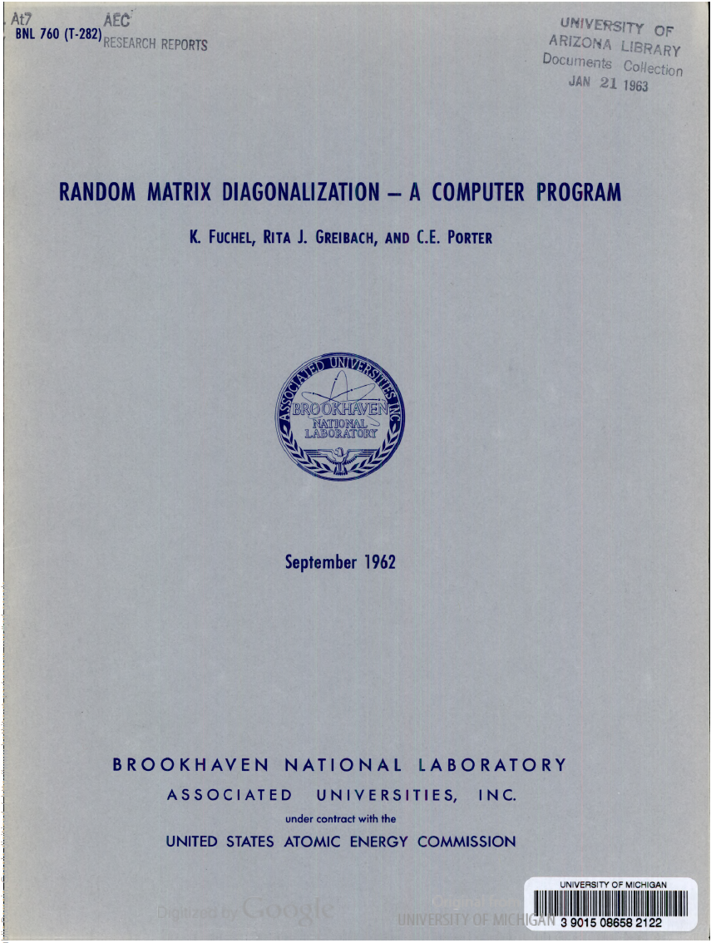
Random Matrix Diagonalization
1962 Fortran Program
[Fuchel, Greibach and Porter,
Brookhaven NL-TR BNL 760 (T-282)
1962]
QR was just about being invented at this time

Slide 18
On an Integral Geometry Inspired Method for Conditional Sampling from Gaussian Ensembles

Slide 19
Outline
Motivation: General β Tracy-Widom
Crofton’s Formula
The Algorithm for
  Conditional Probability
  Special Case: Density Estimation
Code
Application: General β Tracy-Widom

Slide 20
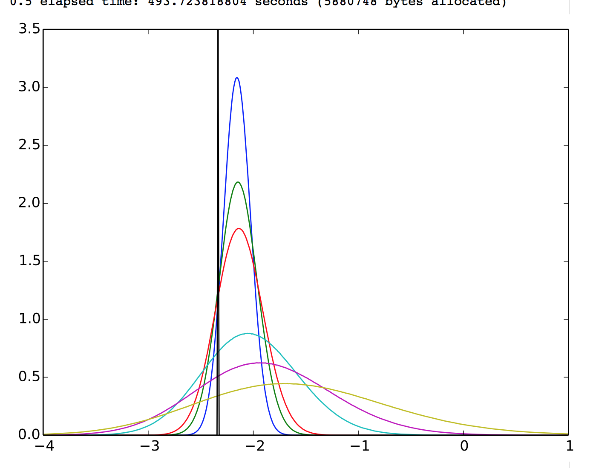
Motivating Example:
General β Tracy-Widom
α=0
α=2/β
α=.02
α=.04
α=.06
β=4
β=2
β=1

Slide 21
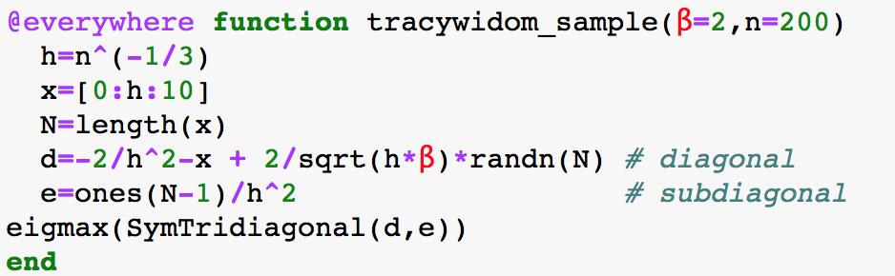
Motivating Example:
General β Tracy-Widom
α=0
α=2/β
α=.02
α=.04
α=.6
β=4
β=2
β=1

Slide 22
Motivating Example:
General β Tracy-Widom
α=0
α=2/β
(Persson, Sutton, Edelman, 2013)
Small α: Constant Coeff Convection Diffusion
Key Fact:
Can march forward in time by adding
a new [constant x dW] to the operator
Mystery:
How to march forward the law itself.
(This talk: new tool, mystery persists)
Question:
Conditioned on starting at a point, how do
we diffuse?
α=.02
α=.04
α=.06
β=4
β=2
β=1

Slide 23
Need Algorithms for cases such as
Non-Random
Random
 | same matrix | nonrandom perturbation | random scalar perturbation | random vector perturbation
Sampling Constraint (what we condition on)
Derived Statistics (what we histogram)
Can we do better than naïve discarding of data?

Slide 24
The Competition:
Markov Chain Monte Carlo?
MCMC: Design a Markov chain whose stationary distribution is the conditional probability for a very small bin.
Need an auxiliary distribution
  Designing Markov chain with fast mixing can be very tricky
  Difficult to tell how many steps Markov chain needs to (approximately) converge
Nonlinear solver needed
  Unless we can march along the constraint surface somehow

Slide 25
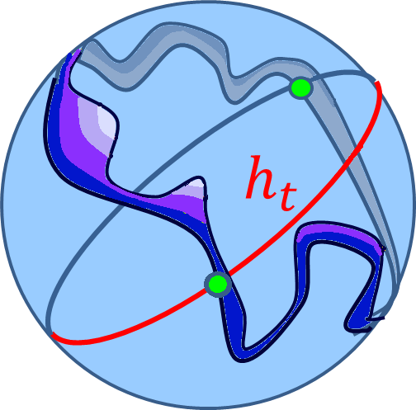
Conditional Probability on a Sphere
Conditional probability comes with a thickness
e.g. is
a ribbon surface
-3+ε
-3+ε
-3
-3
-3+ε
-3

Slide 26

Crofton Formula for hypersurface volume
random great circle (uniform)
fixed manifold
$$M$$
Ambient dim = n
3 | Great circle | Curve
4 | Great circle | Surface
5 | Great circle | Hypersurface
h
Morgan Crofton (1826-1915)

Slide 27
Ribbon Areas
Conditional probability comes with a thickness
  e.g.
  a ribbon surface
thickness= 1/gradient
Ribbon are from Crofton + Layer Cake Lemma
-3+ε
-3+ε
δ
δ
-3
δ
δ
-3
-3+ε
-3

Slide 28
Solving on Great Circles
  e.g. A = tridiagonal with random diagonal
is spherically symmetric
  concentrates on
generate random great circle
  every point on is an
solve for on with
h

Slide 29

The Algorithm at Work

Slide 30
The Algorithm at Work

Slide 31
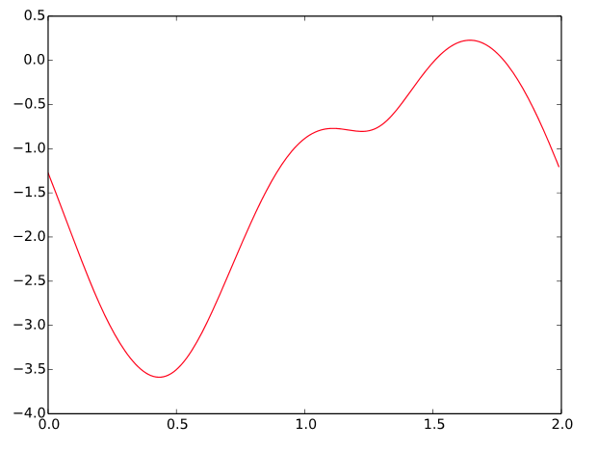
The Algorithm at Work

Slide 32
The Algorithm at Work

Slide 33
The Algorithm at Work

Slide 34
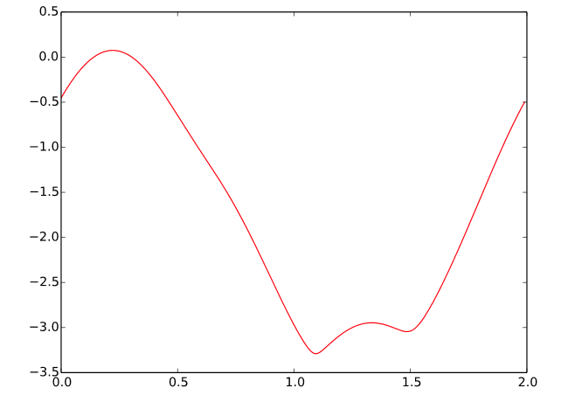
The Algorithm at Work

Slide 35
The Algorithm at Work

Slide 36
The Algorithm at Work

Slide 37
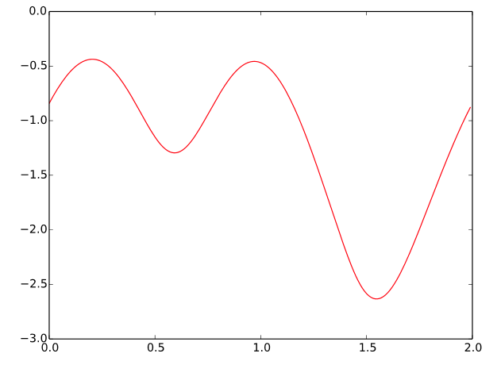

Nonlinear Solver
\
\

Slide 38
Conditional Probability
Every point on the ribbon is weighed by the thickness
Don’t need to remember how many great circles
Let be any statistic
  e.g.,
  e.g.,

Slide 39


Special Case: Density Estimation
Want to compute probability density at a single point for some random variable
  Say,
  Naïve Approach: use Monte Carlo, and see what fraction of points land in bin
  Very slow if is small
?
λ_{max}
Notes:
Say you want the n=216 truncation here

Slide 40
Special Case: Density Estimation
Conditional probability comes with a thickness
  e.g.
  a ribbon surface
thickness= 1/gradient
Ribbon are from Crofton + Layer Cake Lemma
-3+ε
-3+ε
δ
δ
-3
δ
δ
-3
-3+ε
-3

Slide 41
A good computational trick is also a good theoretical trick….

Slide 42
Integral Geometry and Crofton’s Formula
Rich History in Random Polynomial/Complexity Theory/Bezout Theory
  Kostlan, Shub, Smale, Rojas, Malajovich, more recent works…
We used it in: How many roots of a random real-coefficient polynomial are real?
Should find a better place in random matrix theory
Notes:
Bezout theorem V (smale and schub)
Larry Guth
What manifold? What exact application?
“Edelman Costlan Schub—generalized eigenvalue problems”

Slide 43

Our Algorithm

Slide 44






Using the Algorithm, in
Step 1: sampling constraint
Step 2: derived statistic
Step 4: parameters
Step 3: ||gradient(sampling constraint)||
e.g.,
Step 5: run the algorithm
Notes:
separate f
for derived statistic, put the other example derived statistics, but commented out
change gradient to norm of gradient

Slide 45
Using the Algorithm, in
Step 1: sampling constraint
Notes:
separate f
for derived statistic, put the other example derived statistics, but commented out
change gradient to norm of gradient

Slide 46
Using the Algorithm, in
Step 2: derived statistic
Notes:
separate f
for derived statistic, put the other example derived statistics, but commented out
change gradient to norm of gradient

Slide 47
Using the Algorithm, in
Step 3: ||gradient(sampling constraint)||
  e.g.,
Notes:
separate f
for derived statistic, put the other example derived statistics, but commented out
change gradient to norm of gradient

Slide 48
Using the Algorithm, in
Step 4: parameters
Notes:
separate f
for derived statistic, put the other example derived statistics, but commented out
change gradient to norm of gradient

Slide 49


Using the Algorithm, in
Step 5: run the algorithm
Notes:
note: here r = -2.338*3/2

Slide 50
Conditional Probability Example: Evolving Tracy-Widom
is equivalent to
where
Discretized this is a tridiagonal matrix.
Step 1: We can condition on the largest eigenvalue.
Step 2: We can add to the diagonal and histogram the new eigenvalue
Notes:
N=10^4
beta=2;
beta2= 1;
h=N^(-1/3);
x=[0:h:10];
n = length(x)
b=(1/h^2)*ones(n-1);
A=-(2/h^2)*ones(n);
A=A-x;
T = SymTridiagonal(A+(2/sqrt(beta))*a_t*sqrt(h)/h + (sqrt(4/beta2-4/beta))*randn(n)*sqrt(h)/h,b)

Slide 51


Conditional Probability Example:
Numerical Example Results
Want conditional density
By “evolving” the same samples that we used for estimating the density we can also generate a histogram of the conditional density
TW2 (Painleve)
Conditioned TW
Airy Root
Notes:
TW2 superimposed on $f(λ(β=1)|λ\left(β=2\right)=−2.338)$
Alan will add a slide with TW for lots of different betas
Conditioned TW for ½ airy root, 0, and 1.5 airy root, with shifted painleve to compare

Slide 52



Slide 53


Slide 55


Slide 56

Condition on
Evolve β=2 spike to β=1
@β=2
reference TW₂ translated to
diffusion of @β=2 to β=1
←Condition at β=2
TW₂+ζ/2
TW₂
TW₂-ζ/2
TW₂-ζ
just for reference
(significance of λ₁= ζ)
watch blue curves convect & diffuse from black spikes
strong convection
weak diffusion
weak convection
strong diffusion

Slide 57

Complexity Comparison:
Suppose we reduce the bin size – we can imagine some physical Catastrophic System Failure cases
Naïve Algorithm
Log scale
Great Circle Algorithm
Smaller bin sizes cause the naïve algorithm to be very wasteful.
Great circle algorithm hardly cares.
Notes:
Note: r = -10*error, error = ½ bin size
Note: smallest two bins are extrapolated for the naïve algorithm, but all bin sizes are computed for the great circle algorithm

Slide 58
Possible Extension:
Conditioning on large numbers of variables
  Higher Dimensional versions of Crofton’s formula
  Intersections of higher dimensional spheres with lower dimensional manifolds

Slide 59
Applications
MLE for covariance matrix rank estimation
  Most covariance matrix models do not have analytical solution for eigenvalue densities
Heavy tailed random matrices
Molecular interaction simulations (conditioning on the rare phase change)
Stochastic PDE (also functions of )
  Weather simulation (conditioning on today’s incomplete weather, what is the probability of rain tomorrow?)
  Probability of airplane crashing (rare event)
Deriving theoretical bounds for conditional probability ?? Other theory??

Slide 60



Acknowledgements
NDSEG Fellowship
Air Force Office of Scientific Research
NSF DMS 1035400 and DMS 1016125

