Slide 1
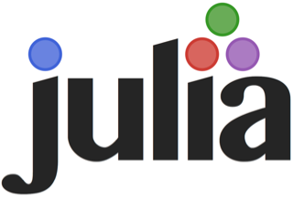
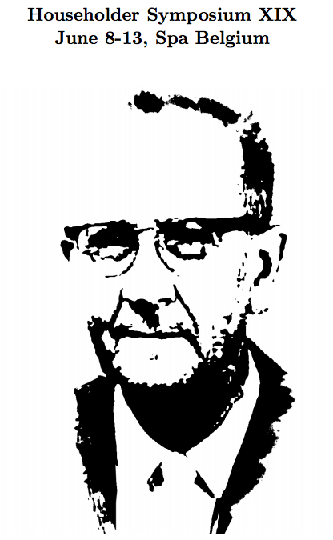

Alan Edelman
Mathematics
Computer Science & AI Laboratories
June 9, 2014
Jeff Bezanson, Stefan Karpinski, Viral Shah and may collaborators worldwide
Try Julia/Ijulia today
google: julia → downloads
8pm room 4

Slide 2
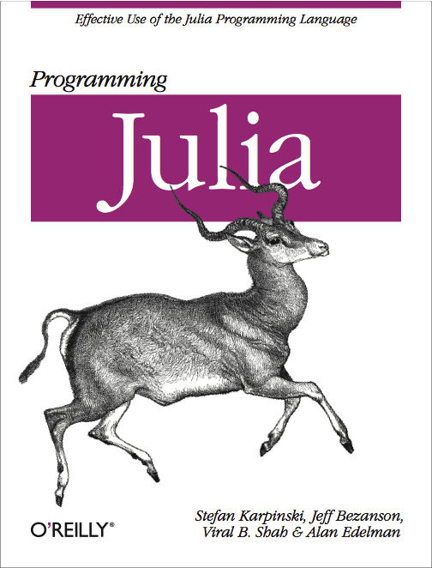
Stereotypes
Computer Scientists don’t take derivatives
but computer scientists are great at abstractions
Computational Scientists can’t declare types
but computational scientists are great at engineering simulations and numerical algorithms

Slide 3



Object-oriented programming with classes
methods
objects
What can I do with/to a thing?
buy
top up
pay fare
lose
class-based OO
classes are more
fundamental
than methods
buy
top up
pay fare
lose
buy
pay fare
lose

Slide 4

Object-oriented programming with multi-methods
What can I do with/to a thing?
buy
multimethods
relationships between
objects and functions
top up
pay fare
lose
generic
function
methods
objects

Slide 5
Multi-methods with type hierarchy
buy
rechargeable
subway
pass
top up
subway
ticket
pay fare
single-use
subway
ticket
lose
generic
function
methods
objects
abstract object
is a subtype of

Slide 6
Abstractions
Poincaré quipped:
“Mathematics is the art of giving the same name to different things.”
Technical computing is the art of applying operations to objects with the same name that represent different things.
-- The Julia Team

Slide 7
Multi-methods for linear algebra
What can I do with/to a thing?
find eigenvalues
eigvals
general matrix
Matrix
find eigenvalues and eigenvectors
eigfact
symmetric tridiagonal matrix
find singular values
SymTridiagonal
svdvals
bidiagonal matrix
find singular values and vectors
Bidiagonal
svdfact
generic
function
methods
objects
Methods can take advantage of special matrix structures

Slide 8
The “Two Language” Problem
As long as the developers’ language is harder than the users language, technical computing will always be hindered

Slide 9
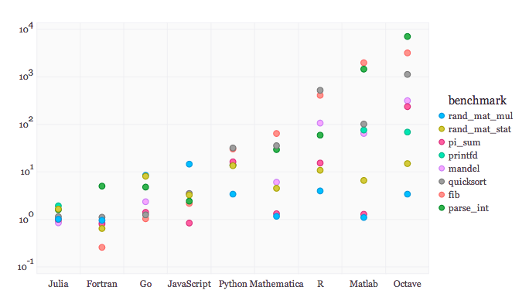
What might you ask from your language?
A whole laundry list of easy to call functions:
  http://julia.readthedocs.org/en/latest/packages/packagelist/
Performance
Can develop libraries
Flexibility
Parallelism
Abstractions
Easy to call other languages/unnecessary to call …

Slide 10
Notebooks to demo
What is multiple dispatch?
iterators
Inspired today
Parallel Tracy widom
Web server
Block SVD
Fractals
Linear Algebra Tutorial
The Colors of Chemistry

