Slide 1
Fields Institute Talk
Note first half of talk consists of blackboard
  see video:
    http://www.fields.utoronto.ca/video-archive/2013/07/215-1962
  then I did a matlab demo
    t=1000000; i=sqrt(-1);figure(1);hold off
    for p=10.^[-3:.2:3]
    % Florent's two coin tosses
    a=pi+angle(-1/p+randn(t,1)+i*randn(t,1));
    r=2*cos(a/4);
    % Draw the symmetrized density
    [x,y]=hist([-r r],linspace(-2,2,99));
    bar(y,x/sum(x)/(y(2)-y(1)));
    title(['p= ' num2str(p)]);
    pause(0.1)
    end
  and finally these slides show up around 34 minutes in

Slide 2
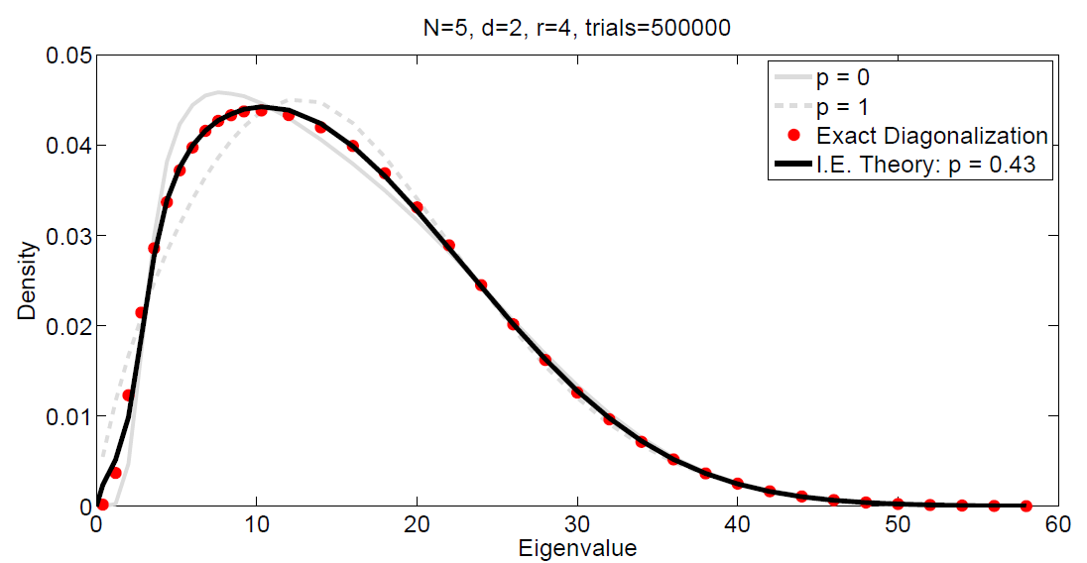
Example Result p=1 → classical probability p=0→ isotropic convolution (finite free probability)
We call this “isotropic
entanglement”

Slide 3
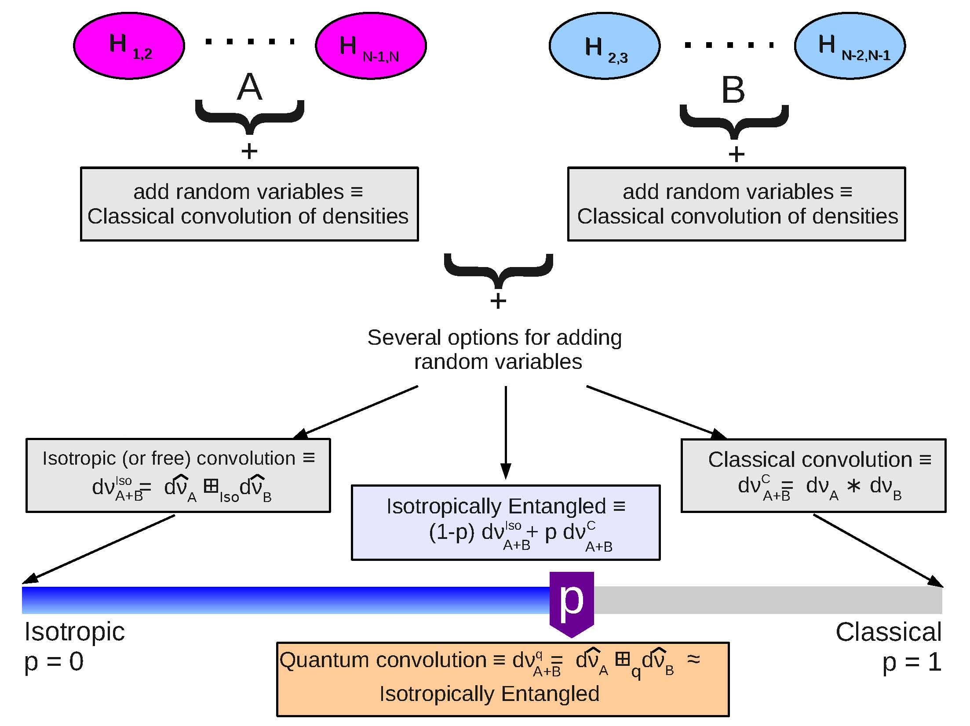
Complicated Roadmap

Slide 4
Complicated Roadmap

Slide 5
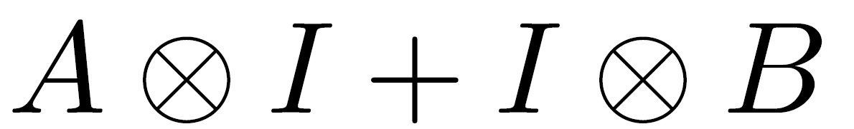
Preview to the Quantum Information Problem
mxm nxn
mxm nxn
Summands commute, eigenvalues add
If A and B are random → eigenvalues are
classical sum of random variables

Slide 6
Closer to the true problem
d²xd² dxd
dxd d²xd²
Nothing commutes, eigenvalues non-trivial

Slide 7
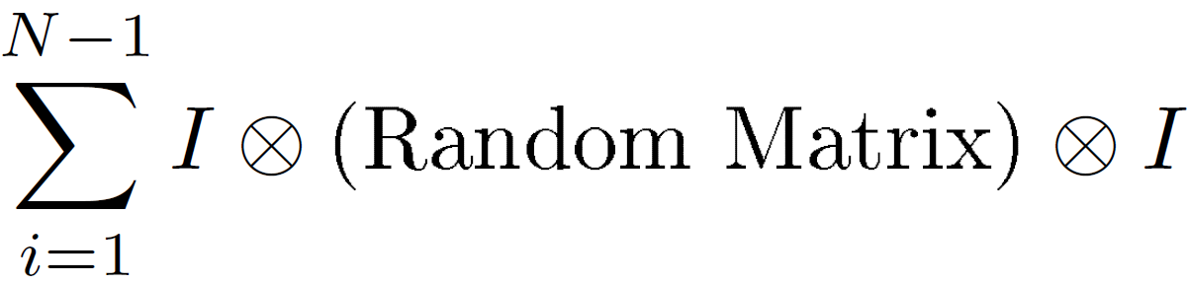
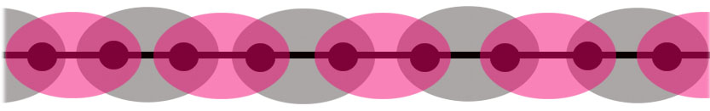
Actual Problem
d^{i-1}xd^{i-1} d²xd² d^{N-i-1}xd^{N-i-1}
The Random matrix could be Wishart,
Gaussian Ensemble, etc (Ind Haar Eigenvectors)
The big matrix is d^{N}xd^{N}
Interesting Quantum Many Body System Phenomena tied to this overlap!

Slide 8

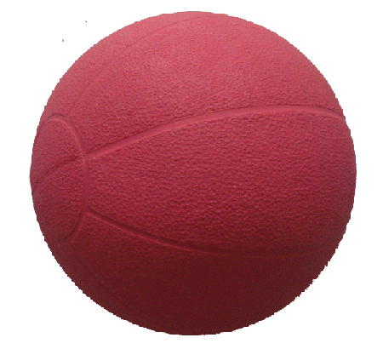
Intuition on the eigenvectors
Classical Quantum Isotropic
Intertwined Kronecker Product of Haar Measures

Slide 9
Example Result p=1 → classical convolution p=0→ isotropic convolution

Slide 10
First three moments match theorem
It is well known that the first three free cumulants match the first three classical cumulants
Hence the first three moments for classical and free match
The quantum information problem enjoys the same matching!
Three curves have the same mean, the same variance, the same skewness!
Different kurtoses (4th cumulant/var²+3)

Slide 11
Fitting the fourth moment
Simple idea
Worked better than we expected
Underlying mathematics guarantees more than you would expect
  Better approximation
  Guarantee of a convex combination between classical and iso

Slide 12
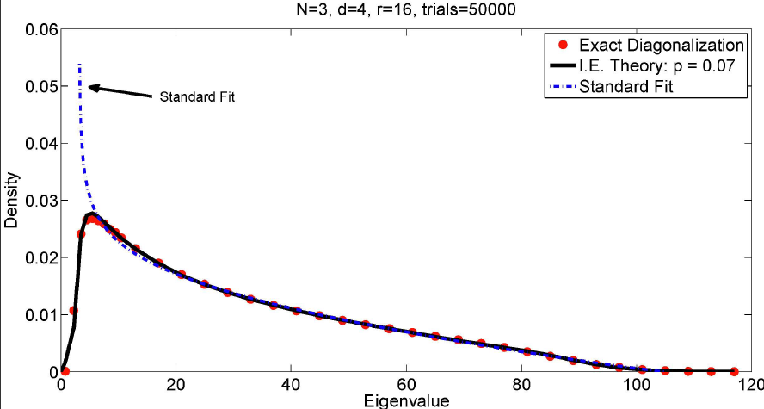
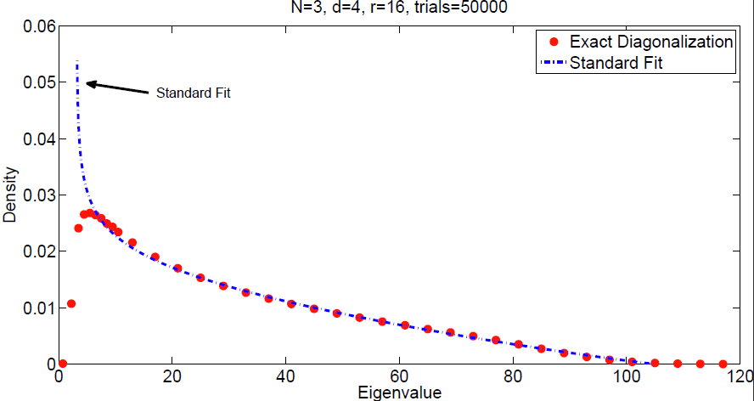
Illustration

Slide 13
Roadmap

Slide 14
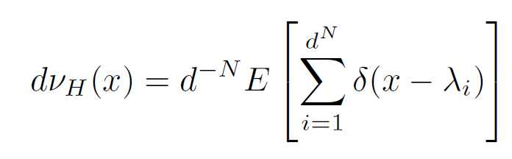
The Problem
Let H=
d^{i-1}xd^{i-1} d²xd² d^{N-i-1}xd^{N-i-1}
Compute or approximate

Slide 15
The Problem
Let H=
d^{i-1} d² d^{N-i-1}
The Random matrix has known joint eigenvalue density
& independent eigenvectors distributed with β-Haar measure .
β=1 random orthogonal matrix
β=2 random unitary matrix
β=4 random symplectic matrix
General β: formal ghost matrix

Slide 16
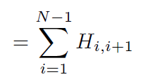
Easy Step
H=
= (odd terms i=1,3,…) + (even terms i=2,4,…)
Eigenvalues of odd (even) terms add
= Classical convolution of probability densities
(Technical note: joint densities needed to preserve all the information)
Eigenvectors “fill” the proper slots

Slide 17
Complicated Roadmap

Slide 18
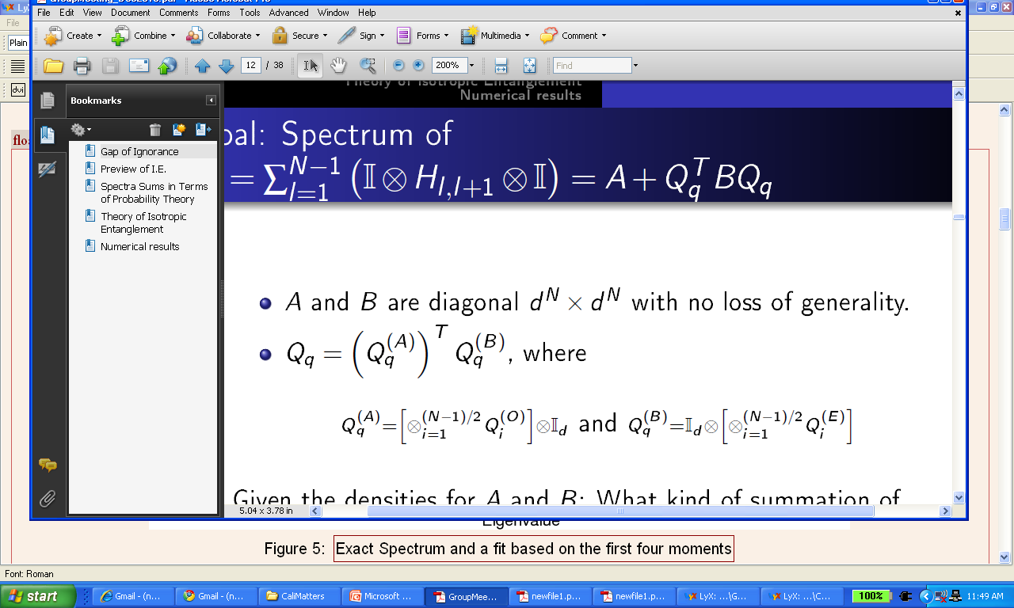
Eigenvectors of odd (even)
Odd
Even
Quantify how we are in between
Q=I and the full Haar measure

Slide 19
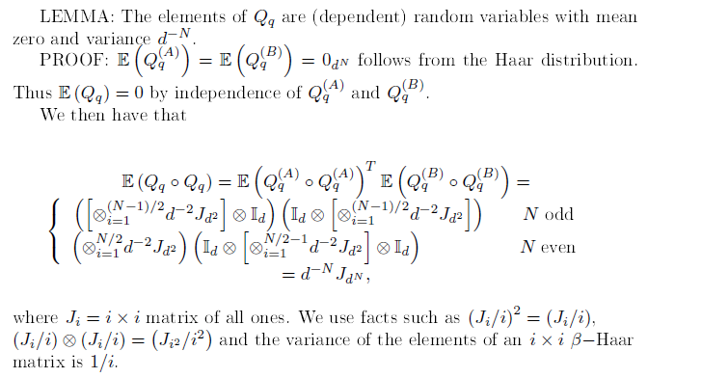
The same mean and variance as Haar

Slide 20
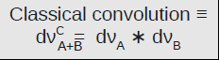
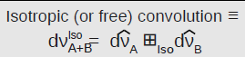
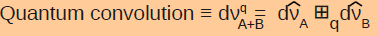
The convolutions
Assume A,B diagonal. Symmetrized ordering.
A+B:
A+Q’BQ:
A+Q_{q}’BQ_{q}
(“hats” indicate joint density is being used)

Slide 21
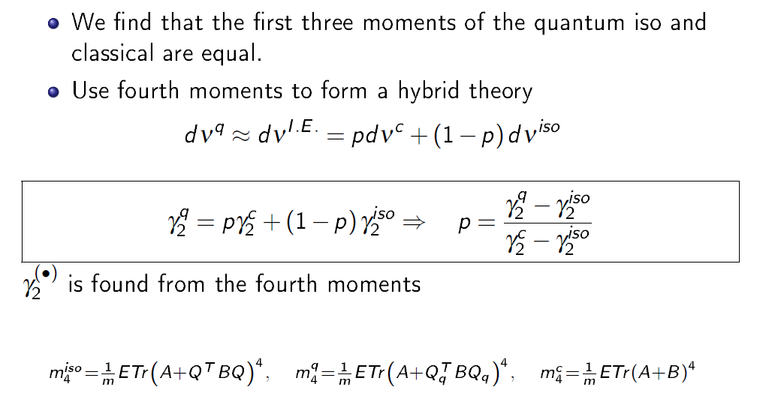
The Istropically Entangled Approximation
The kurtosis
But this one is hard

Slide 22
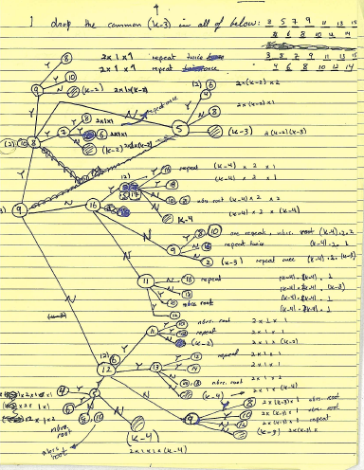
A first try:
Ramis “Quantum Agony”

Slide 23
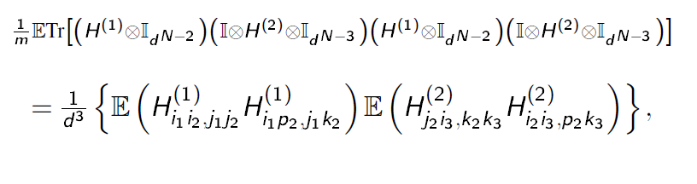
The Entanglement

Slide 24
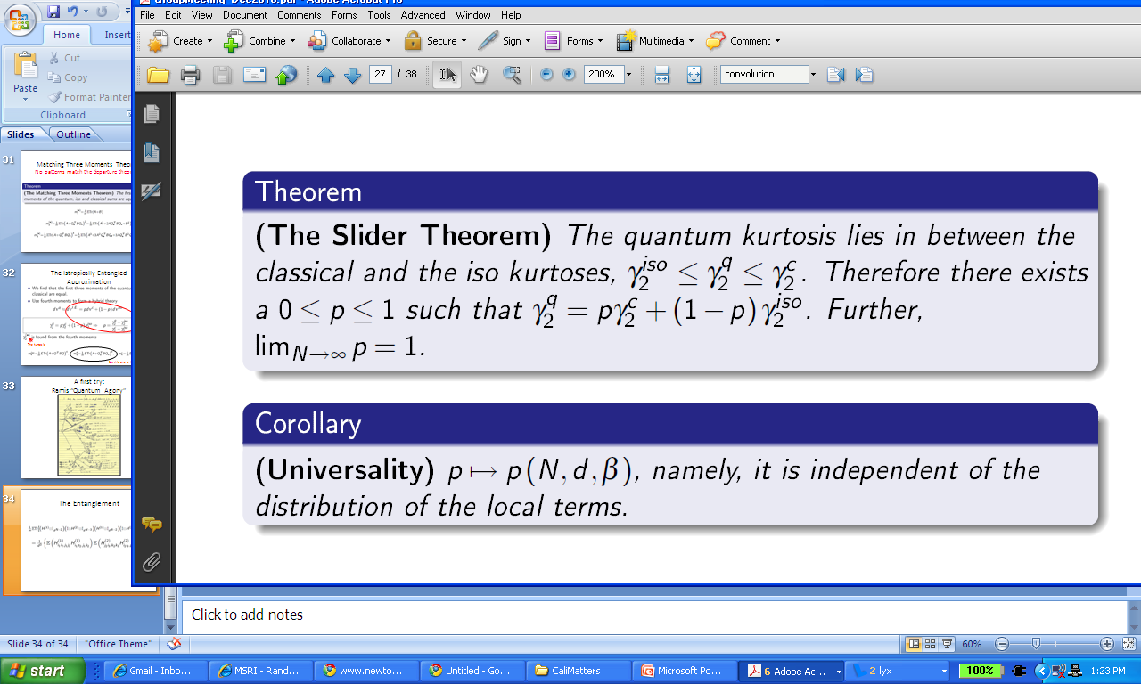
The Slider Theorem
p only depends on the eigenvectors! Not the eigenvalues

Slide 25
More pretty pictures

Slide 26
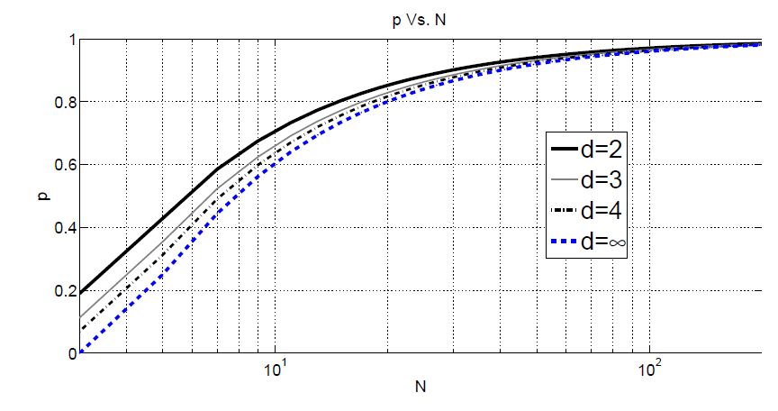
p vs. N large N: central limit theorem large d, small N: free or iso whole 1 parameter family in between
The real world? Falls on a 1 parameter family

Slide 27
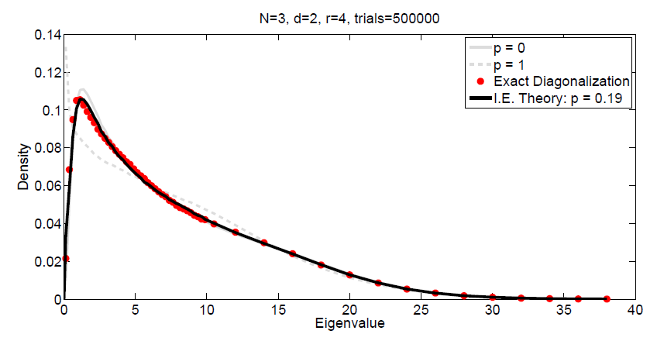
Wishart

Slide 28
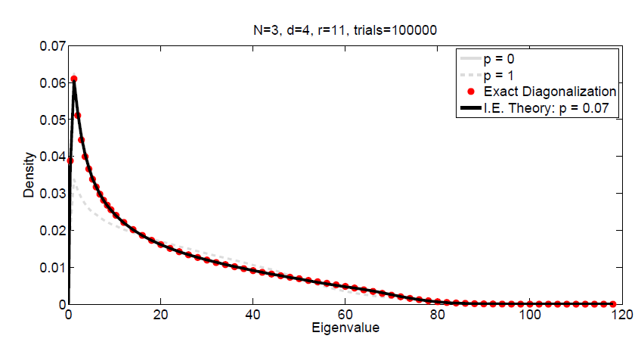
Wishart

Slide 29
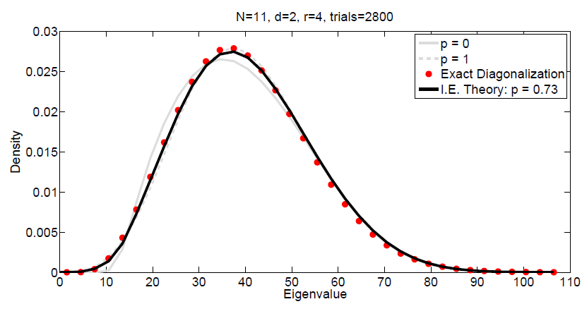
Wishart

Slide 30
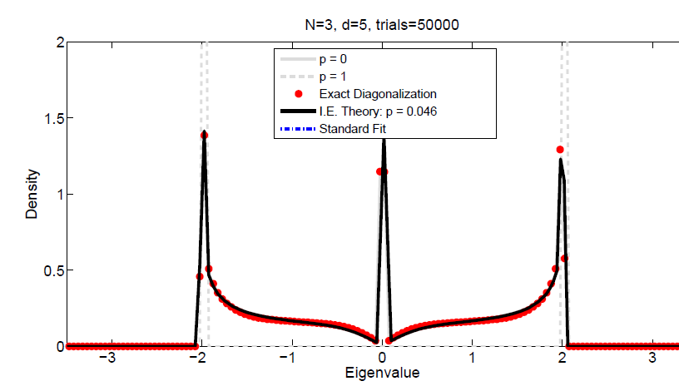
Bernoulli ±1

Slide 31
Roadmap

