Slide 1


Alan Edelman, Jeff Bezanson
Viral Shah, Stefan Karpinski
students in 18.337
and the greater community
Computer Science & AI Laboratories

Slide 2
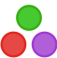
Summary: Our Questions
Design a high performance technical computing environment for today’s world.
What would it look like?
What long-held assumptions could we shake up?
Our answer:

Slide 3
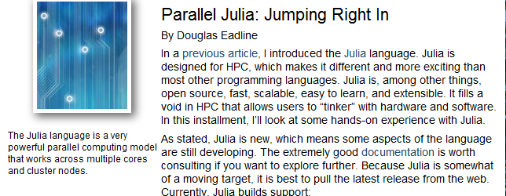
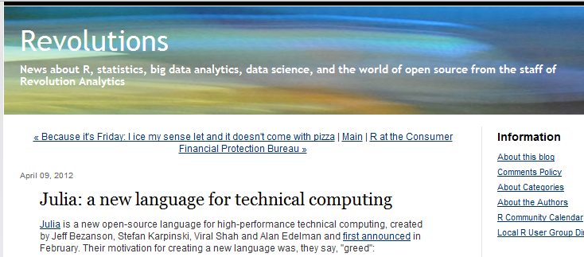
Julia in the headlines

Slide 4
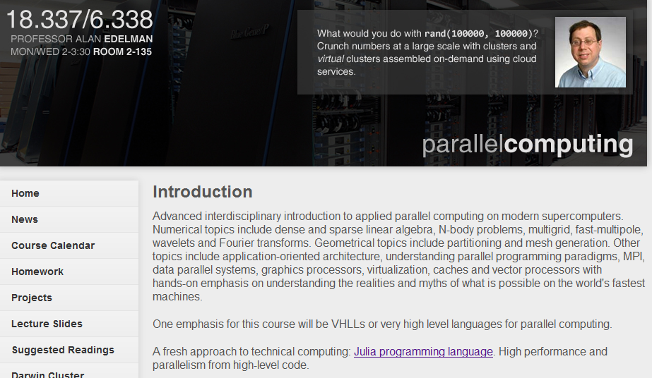
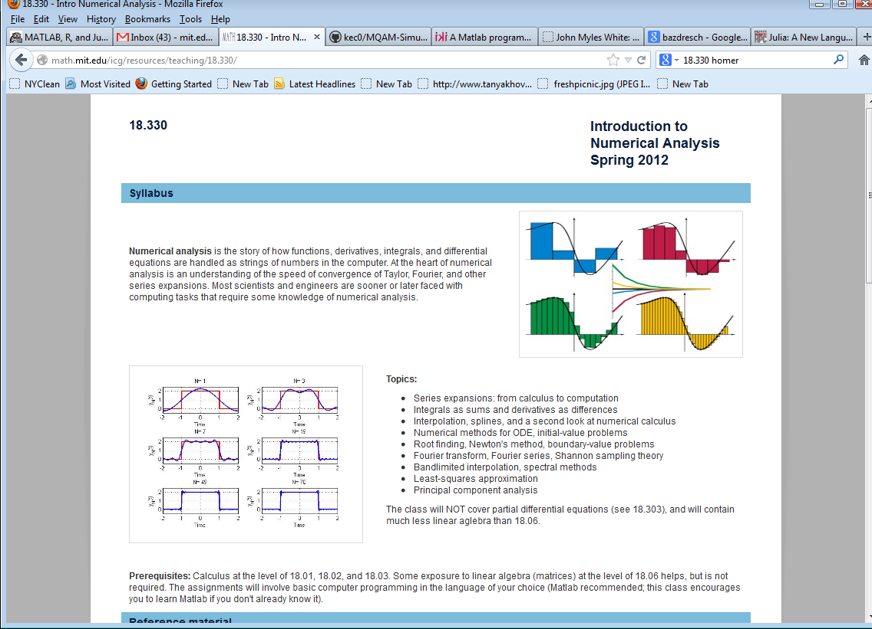
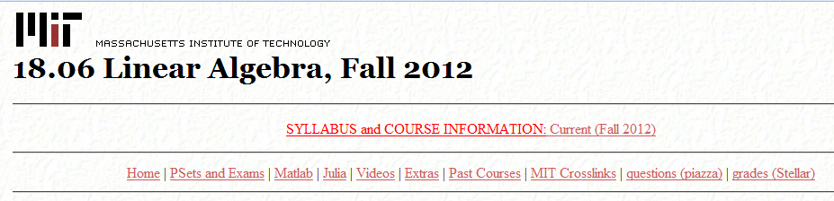
Julia in the classroom
2013 class plans
to use Julia

Slide 5
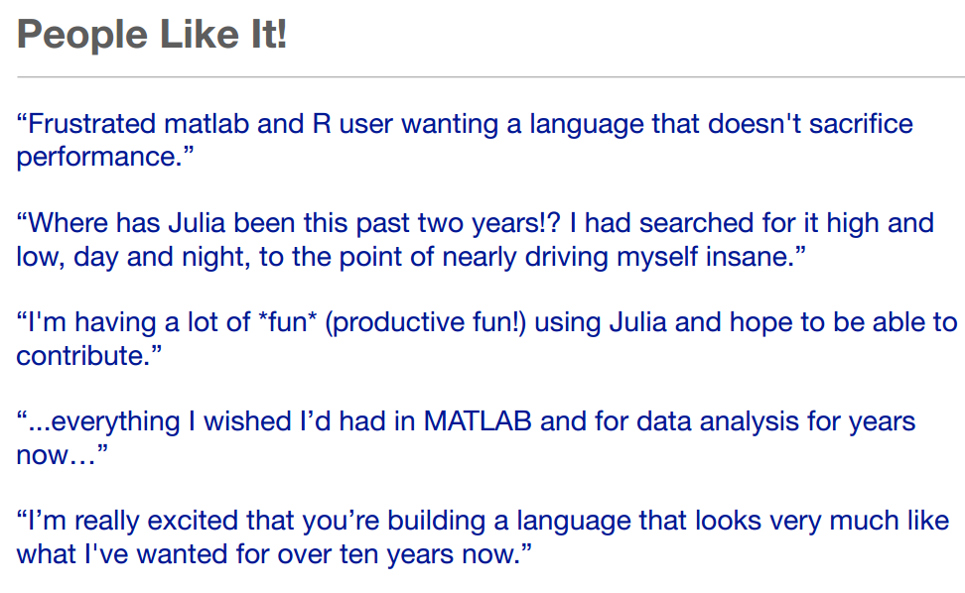

Slide 6






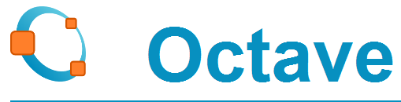

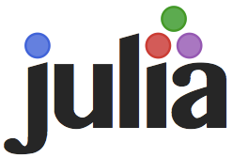
The High Productivity
Technical Computing World
INTERFACES + GLUE METHODOLOGY:
Experts’ numerical libraries
Written in low level languages
☺ Many non-experts gain access
☹ No easy path below highest level
Feel starts out as above
Quickly users drill down, become developers
Soon becomes a brand new technical computing experience

Slide 7
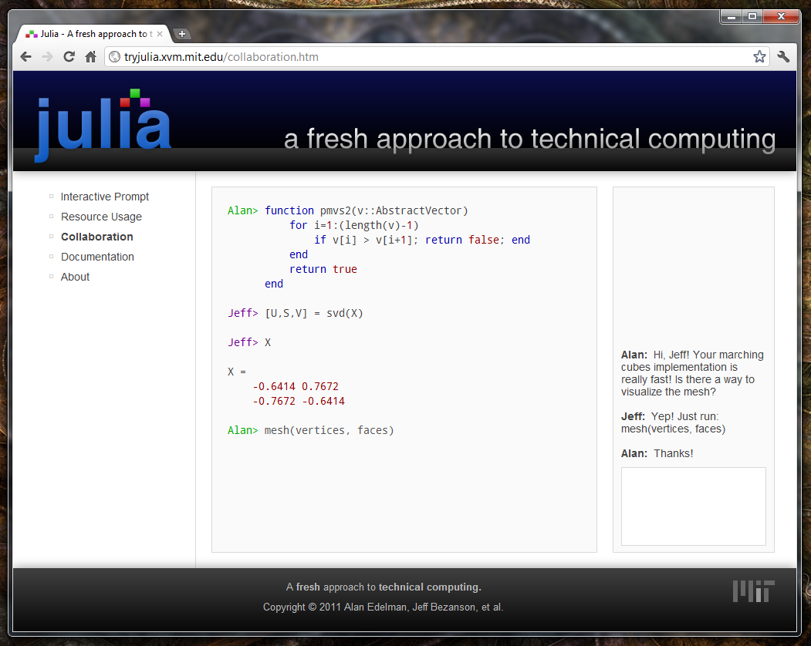
Collaborative Coding (mockup)
Realized in 18.337/6.338
Collaborative coding environment
Send messages to your colleagues in real time
It’s like
having
Google
docs for
coding!

Slide 8

Julia is open source:
Key developers aged 17 to 75
Warning for the older folks: if you haven’t
githubbed yet, it’s highly addictive.
Available Julia Packages
ArgParse,Benchmark,BinDeps,Cairo,Calculus,Calendar,Clp,Clustering,Color,Compose,DataFrames,Debug,DecisionTree,DimensionalityReduction,Distributions,Example,FITSIO,FastaRead,FileFind,GLM,GLUT,Gadfly,GetC,Graphs,Grid,HDF5,HTTP,HypothesisTests,ICU,IniFile,Iterators,Ito,JSON,Jump,KLDivergence,LM,Languages,Loss,MAT,MCMC,Mongrel2,Mustache,NHST,Named,ODBC,OpenGL,Optim,Options,PLX,PatternDispatch,Profile,ProjectTemplate,Rdatasets,Resampling,Rif,SDL,Sims,SymbolicLP,TextAnalysis,TextWrap,Thyme,Tk,Trie,UTF16,WAV,Winston,ZMQ,kNN

Slide 9

Some features:
Julia is fast
  uniprocessor performance first!
  then parallelism
Interactive dynamic programming language
  interactive and fast? Yes! (Interpreted=Slow?)
Solves the two language problem
Personal Goal: New hub for numerical knowledge
  All arcane knowledge organized for once.
  No need to beg to have something fixed – just fix it!
  Link encyclopedia, software, and discussions
    e.g. Should cond(zeros(n,n)) be 0,NaN,Inf, etc
      should we care?

Slide 10
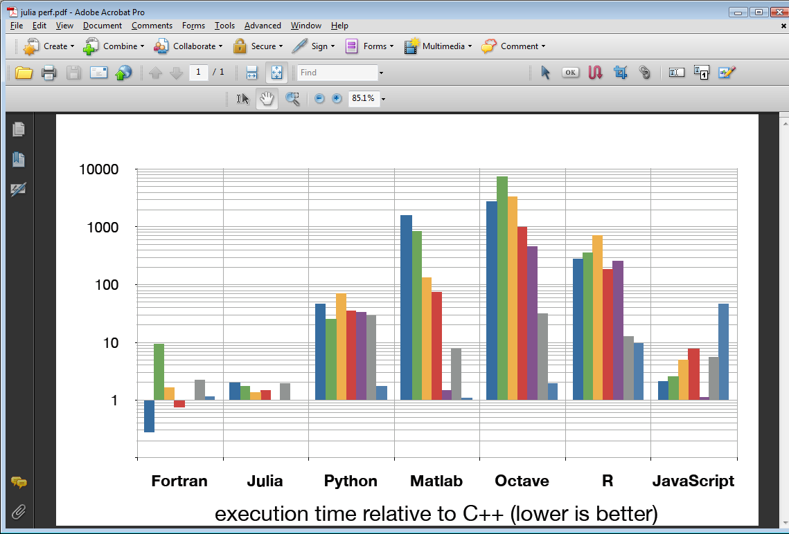
Benchmark
Performance
fib
parse_int
quicksort
mandel
pi_sum
rand_mat_stat
rand_mat_mul

Slide 11
Invoking interest in the R community as a potential successor to R
Community includes key R contributors and influencers:
John Myles White (Princeton, author of Machine Learning for Hackers)
Harlan Harris (Kaplan, Data Science DC)
Doug Bates (Part of S and R teams)
Source: http://www.r-statistics.com/2013/01/100-most-read-r-posts-for-2012-stats-from-r-bloggers-big-data-visualization-data-manipulation-and-other-languages/

Slide 12
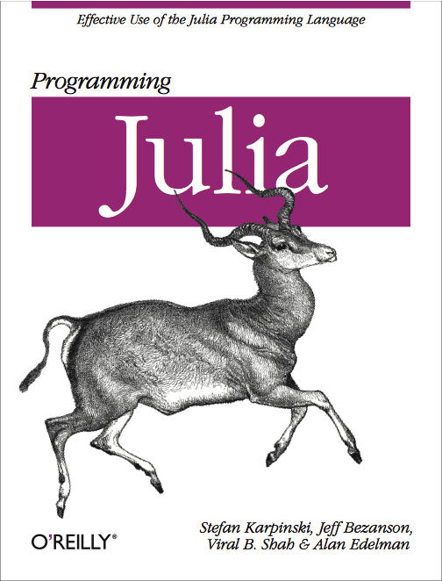

Slide 13
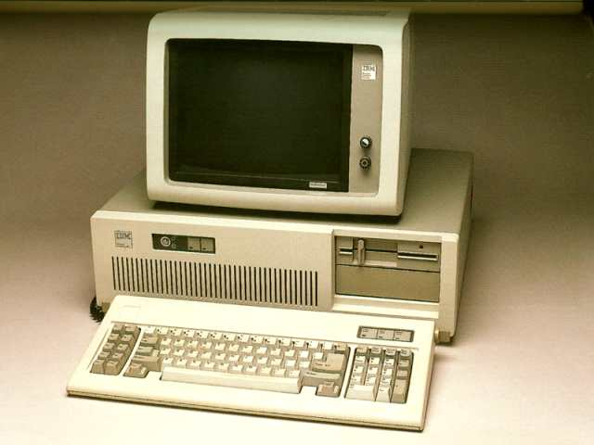
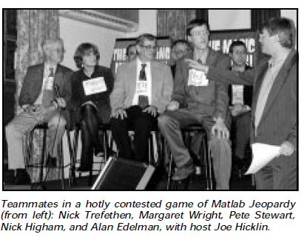

Commercial MATLAB®’s very first student user
(1985) Nick Trefethen buys the first commercial licenses
Edelman uses it on a basement IBM PC-AT
(1993?) First use of MATLAB® for Numerical Analysis (Math128a) at UC Berkeley
MATLAB Jeopardy 1999

Slide 14

Perspectives from a long time MATLAB user:
Little things take getting used to
  Feels backward: A[1,2], (u,s,v)=svd(A)
but you’ll love
  (A-B)[1,2]
  Comprehensions: [1/(i+j) for i=1:5, j=1:5]
At first you may feel insecure, but the time to comfort is smaller than you’ll think
very quickly a whole world opens up that never existed for you before

Slide 15
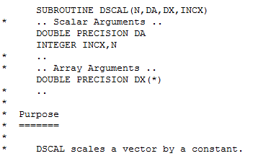
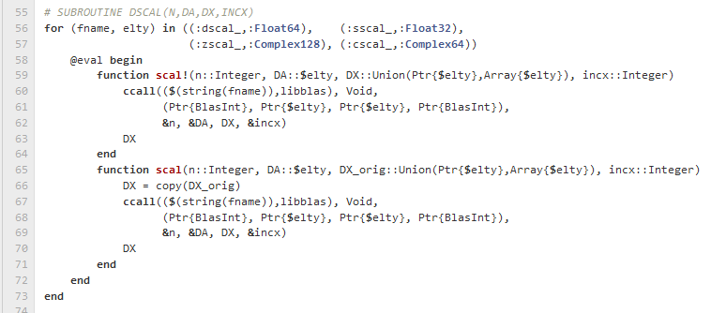
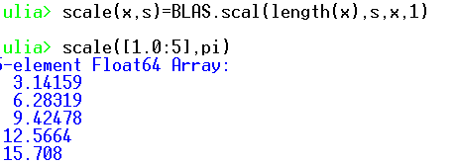
Access to BLAS and LAPACK easy as 1,2,3
1.BLAS
2. Julia Source: GITHUB: julia/base/blas.jl
3. Yours to use

Slide 16
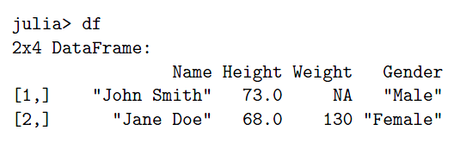
Recent Tutorial at MIT.
(Video in production)
Lightning Round of Quickies, Julia Vision, Parallelism, Multiple Dispatch, Performance
Working with Data in Julia: John Myles White
  Data Frames!
Statistical Models in Julia: Doug Bates
  “R statistics on top of Julia
Optimization: Miles Lubin
  Cutting Planes
Julia for Signal Processing: Steve Johnson
Advanced Interfaces: Keno Fischer, Jameson Nash

Slide 17
