Slide 1
First passage percolation on rotationally invariant fields
Allan Sly
Princeton University
September 2016
Joint work with Riddhipratim Basu (Stanford) and Vladas Sidoravicius (NYU Shanghai)

Slide 2
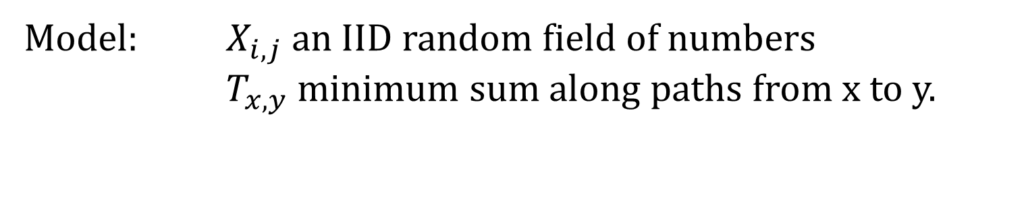
First Passage Percolation
Model: $X_{i,j}$ an IID random field of numbers
$T_{x,y}$ minimum sum along paths from x to y.
1 | 1 | 3 | 5 | 6 | 3 | 9 | 7 | 1 | 8
6 | 4 | 8 | 2 | 1 | 5 | 6 | 8 | 3 | 2
4 | 3 | 4 | 7 | 9 | 1 | 6 | 1 | 2 | 4
5 | 4 | 6 | 2 | 3 | 1 | 8 | 5 | 6 | 9
8 | 4 | 2 | 1 | 8 | 1 | 6 | 8 | 7 | 8
1 | 2 | 1 | 1 | 9 | 1 | 1 | 9 | 1 | 1
9 | 3 | 6 | 6 | 8 | 2 | 1 | 1 | 9 | 2
1 | 7 | 4 | 8 | 5 | 3 | 4 | 1 | 1 | 1
By Subadditive Ergodic Theorem: $\lim{\frac{1}{n}}T_{0,n x}=μ_{x} a.s.$

Slide 3
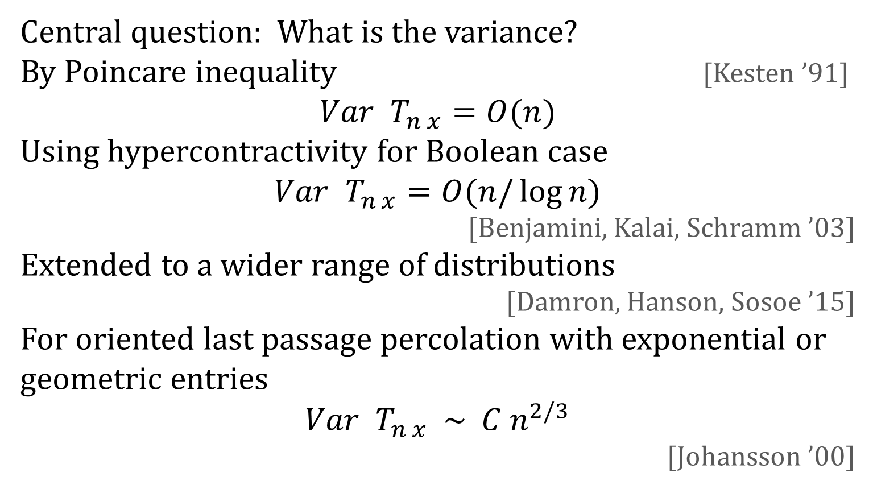
Variance
Central question: What is the variance?
By Poincare inequality [Kesten ’91]
$$Var T_{n x}=O(n)$$
Using hypercontractivity for Boolean case
$$Var{ T}_{n x}=O(n/\log{n})$$
[Benjamini, Kalai, Schramm ’03]
Extended to a wider range of distributions
[Damron, Hanson, Sosoe ’15]
For oriented last passage percolation with exponential or geometric entries
$$Var T_{n x} \sim C n^{2/3}$$
[Johansson ’00]

Slide 4
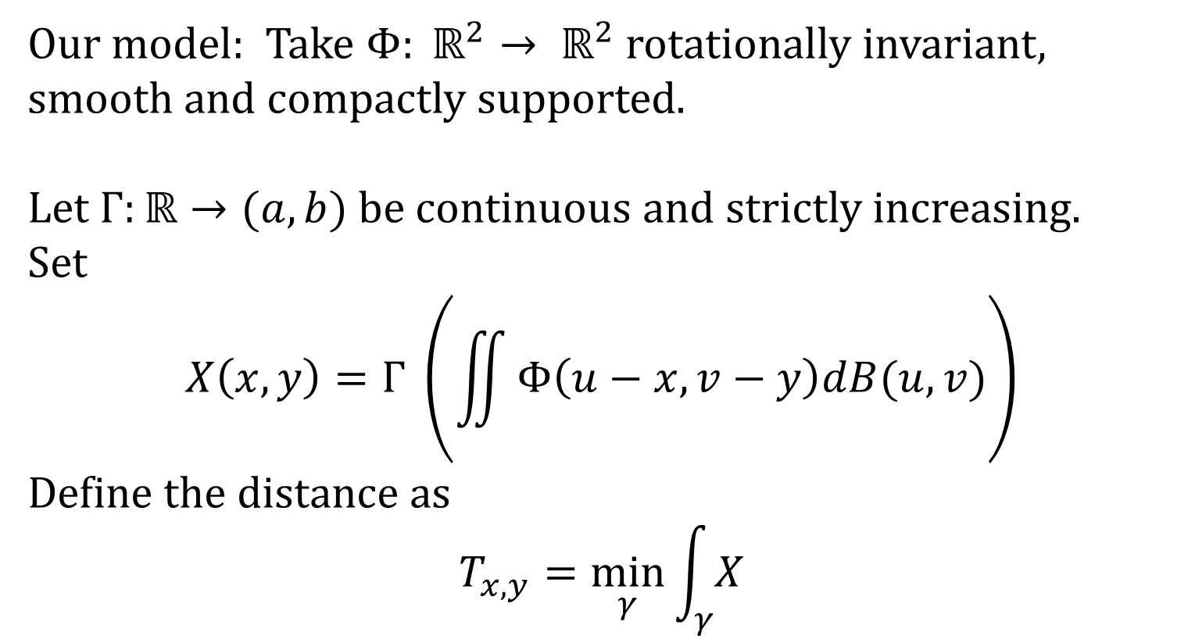
Rotationally Invariant models
Our model: Take $Φ: ℝ^{2}→ ℝ^{2}$ rotationally invariant, smooth and compactly supported.
Let $Γ:ℝ→(a,b)$ be continuous and strictly increasing.
Set
$$X\left(x,y\right)=Γ \left(\iint{Φ\left(u−x,v−y\right)dB(u,v)}\right)$$
Define the distance as
$$T_{x,y}=\min_{γ}{\int_{γ}{X}}$$

Slide 5
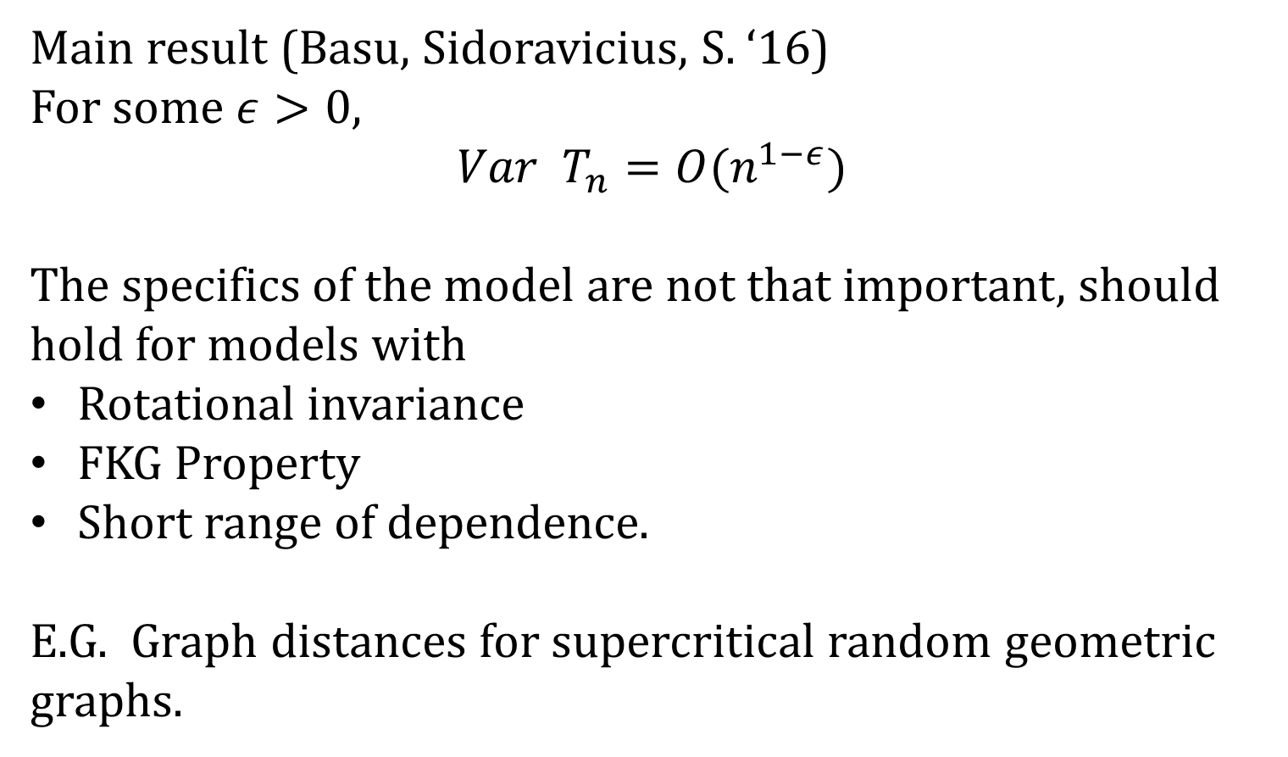
Main Result
Main result (Basu, Sidoravicius, S. ‘16)
For some $ε>0$,
$$Var T_{n}=O(n^{1−ε})$$
The specifics of the model are not that important, should hold for models with
Rotational invariance
FKG Property
Short range of dependence.
E.G. Graph distances for supercritical random geometric graphs.

Slide 6
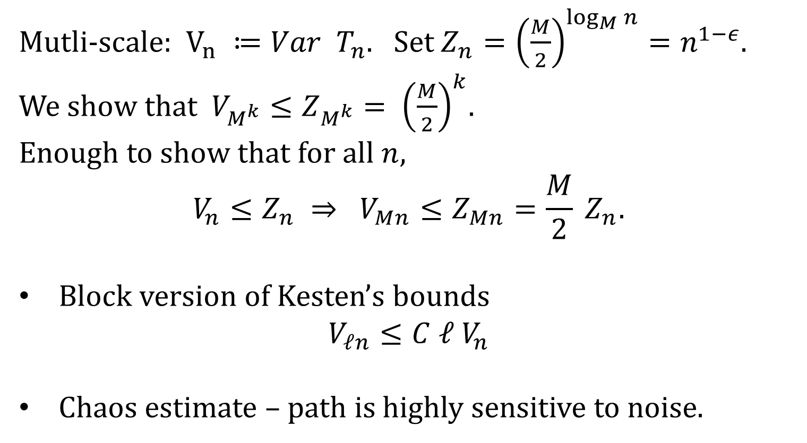
Basic Approach
Mutli-scale: $V_{n} ≔Var T_{n}$. Set $Z_{n}={\left(\frac{M}{2}\right)}^{\log_{M}{n}}=n^{1−ε}$.
We show that $V_{M^{k}}≤Z_{M^{k}}= {\left(\frac{M}{2}\right)}^{k}$.
Enough to show that for all $n$,
$$V_{n}≤Z_{n} ⇒ V_{Mn}≤Z_{Mn}=\frac{M}{2} Z_{n}.$$
Block version of Kesten’s bounds
$$V_{ℓn}≤C ℓ V_{n}$$
Chaos estimate – path is highly sensitive to noise.

Slide 7

Kesten’s martingale argument
Reveal the sites one by one:
$$M_{i}=𝔼 \left[T_{n} \right| ℱ_{i}]$$
Then
$$Var\left[T_{n}\right]=Σ_{i} Var\left[M_{i} −M_{i−1}\right]≤Σ_{i} 𝔼Var \left[T_{n} | ℱ_{i}^{c} \right]$$
The value of block i will only matter if it is on the optimal path so
$$Σ_{i} 𝔼 Var \left[T_{n} | ℱ_{i}^{c} \right] ≍ C𝔼 \#\{i :i∈γ\}≍ Cn$$
With some extra tricks one can also get concentration bounds.

Slide 8

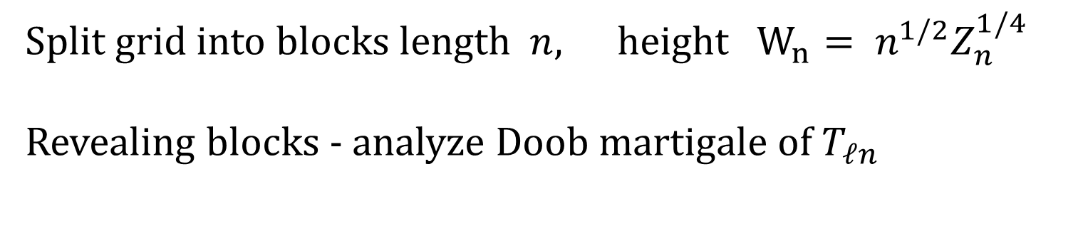
Multiscale version of Kesten argument
Split grid into blocks length $n$, height $W_{n}= n^{1/2}Z_{n}^{1/4}$
Revealing blocks - analyze Doob martigale of $T_{ℓn}$
What we need
Relate point to point with side to side
Variance:
$$V_{ℓn} ≤ C ℓ Z_{n}$$
Concentration:
$$ℙ\left[\left|T_{ℓn} −𝔼 T_{ℓn}\right|≥x \sqrt{ℓZ_{n}}\right]≤ Ce^{−c x^{2/3}}$$
$$\left|𝔼 T_{ℓn} −μ ℓ n\right|≤C \sqrt{ℓ Z_{n}}$$
Transversal Fluctuations of order
$$ℓ^{3/4} W_{n}$$

Slide 9
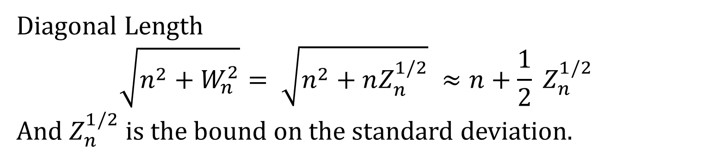
Side to side
Diagonal Length
$$\sqrt{n^{2}+W_{n}^{2}}= \sqrt{n^{2}+nZ_{n}^{1/2}} ≈n+\frac{1}{2} Z_{n}^{1/2}$$
And $Z_{n}^{1/2}$ is the bound on the standard deviation.

Slide 10

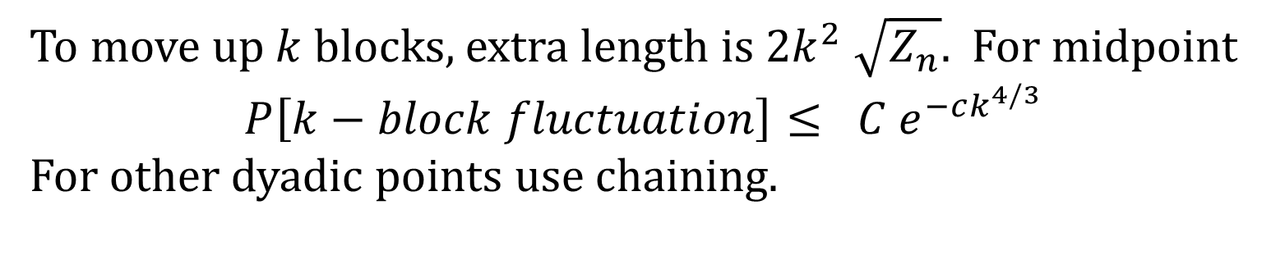

Transversal fluctuations
To move up $k$ blocks, extra length is $2k^{2} \sqrt{Z_{n}}$. For midpoint
$$P\left[k−block fluctuation\right]≤ C e^{−ck^{4/3}}$$
For other dyadic points use chaining.
At least on segment must deviate from its mean by at least $\frac{1}{2}k^{2} \sqrt{Z_{n}}$
$$k W_{n}$$

Slide 11
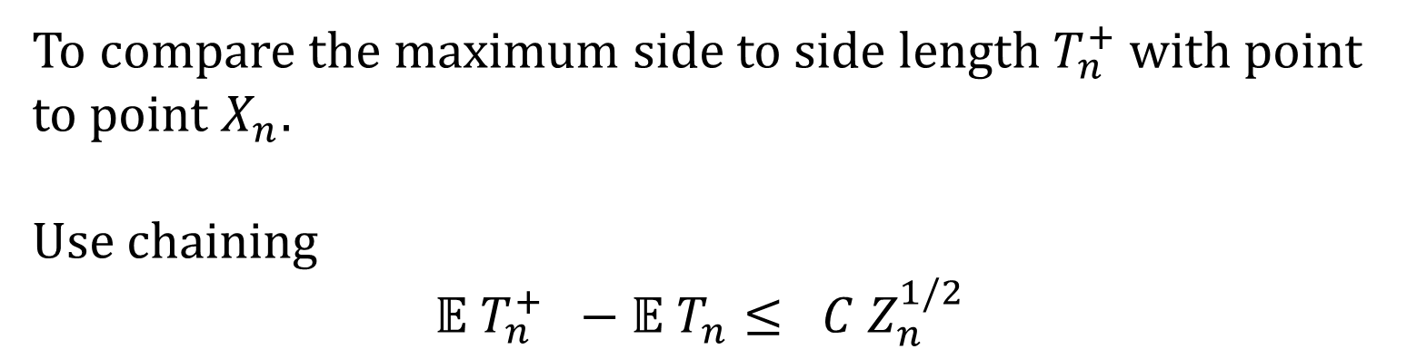
Side to side
To compare the maximum side to side length $T_{n}^{+}$ with point to point $X_{n}$.
Use chaining
$$𝔼 T_{n}^{+} −𝔼 T_{n}≤ C Z_{n}^{1/2}$$

Slide 12
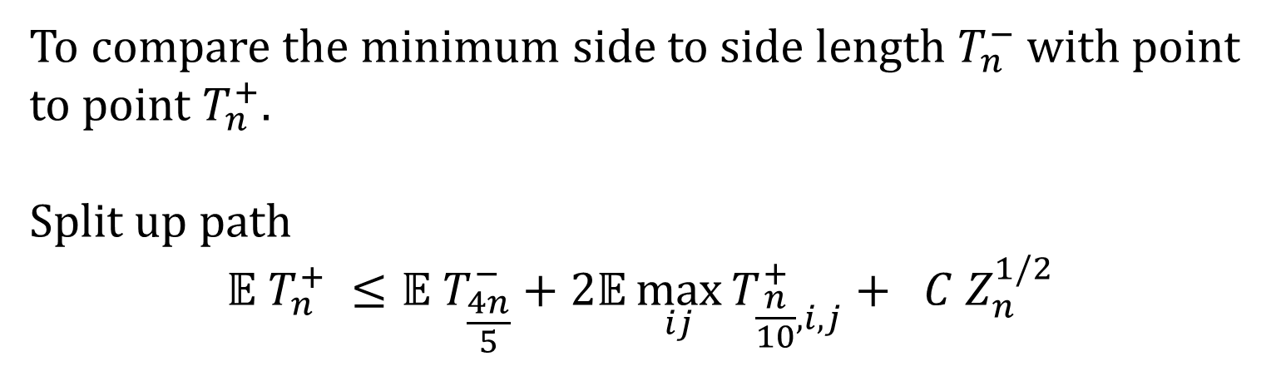
Side to side
To compare the minimum side to side length $T_{n}^{−}$ with point to point $T_{n}^{+}$.
Split up path
$$𝔼 T_{n}^{+} ≤𝔼 T_{\frac{4n}{5}}^{−}+2𝔼\max_{ij}{T_{\frac{n}{10},i,j}^{+}}+ C Z_{n}^{1/2}$$
Max
Min
Max
Max

Slide 13
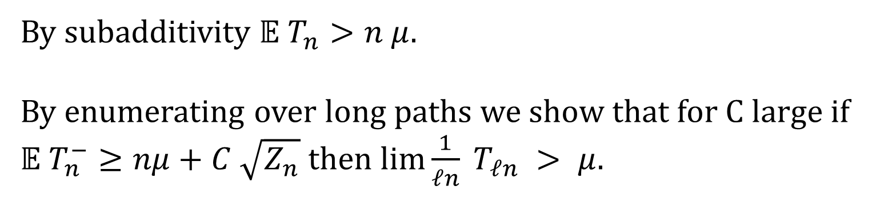

Relating mean to $μ$
By subadditivity $𝔼 T_{n}>n μ$.
By enumerating over long paths we show that for C large if $𝔼 T_{n}^{−}≥nμ+C \sqrt{Z_{n}}$ then $lim\frac{1}{ℓn} T_{ℓn} > μ$.

Slide 14
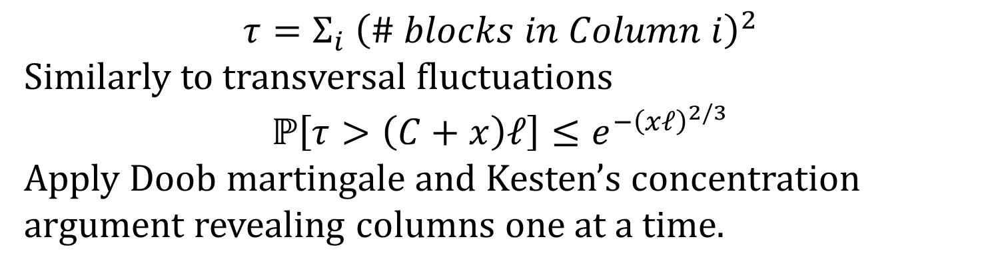
Concentration
$$τ=Σ_{i} {\left(\# blocks in Column i\right)}^{2}$$
Similarly to transversal fluctuations
$$ℙ\left[τ>\left(C+x\right)ℓ\right]≤e^{−{\left(xℓ\right)}^{2/3}}$$
Apply Doob martingale and Kesten’s concentration argument revealing columns one at a time.
Can not take union bound over all paths because of sub-exponential tails

Slide 15
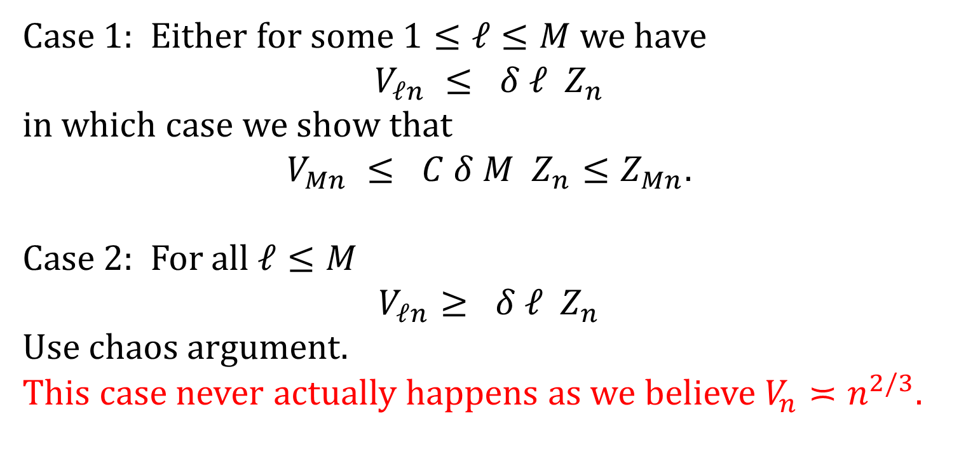
Proof by contradiction
Case 1: Either for some $1≤ℓ≤M$ we have
$$V_{ℓn} ≤ δ ℓ Z_{n}$$
in which case we show that
$$V_{Mn} ≤ C δ M Z_{n}≤Z_{Mn}.$$
Case 2: For all $ℓ≤M$
$$V_{ℓn}≥ δ ℓ Z_{n}$$
Use chaos argument.
This case never actually happens as we believe $V_{n}≍n^{2/3}$.

Slide 16
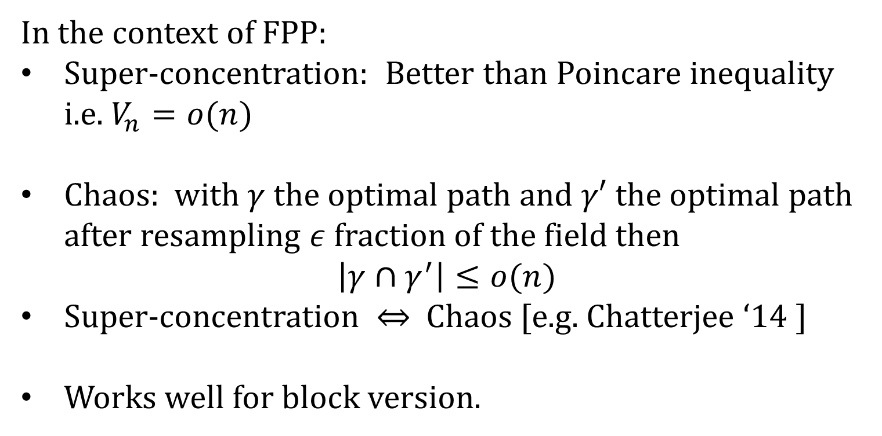
Super-concentration – chaos
In the context of FPP:
Super-concentration: Better than Poincare inequality i.e. $V_{n}=o(n)$
Chaos: with $γ$ the optimal path and $γ′$ the optimal path after resampling $ε$ fraction of the field then
$$\left|γ∩γ^{′}\right|≤o(n)$$
Super-concentration $⇔$ Chaos [e.g. Chatterjee ‘14 ]
Works well for block version.

Slide 17
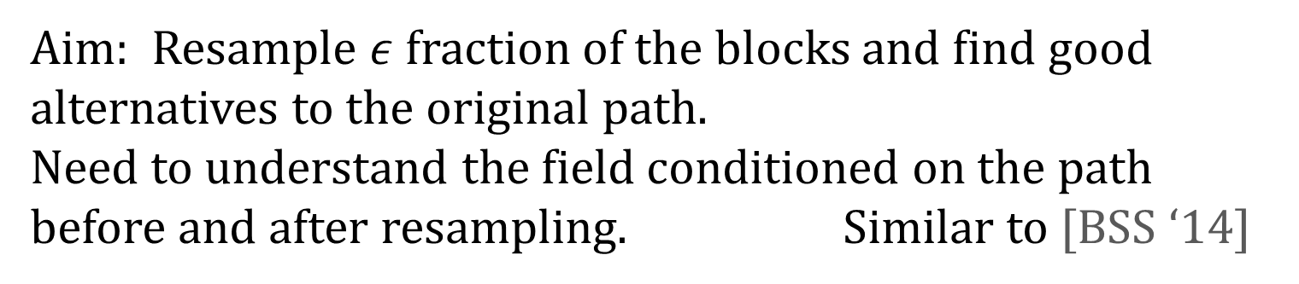
Proving Chaos
Aim: Resample $ε$ fraction of the blocks and find good alternatives to the original path.
Need to understand the field conditioned on the path before and after resampling. Similar to [BSS ‘14]

Slide 18
Percolation type estimates
We have control of the transversal fluctuations of the path.
A percolation estimate says that all paths with reasonable fluctuations spend most of their time in “typical” regions.
Atypical

Slide 19
FKG type estimates
Conditioning on the location and value of the path is a positive event for the rest of the field.
We can use FKG to sample create regions that are very positive which the optimal path must avoid (before and after resampling.

Slide 20
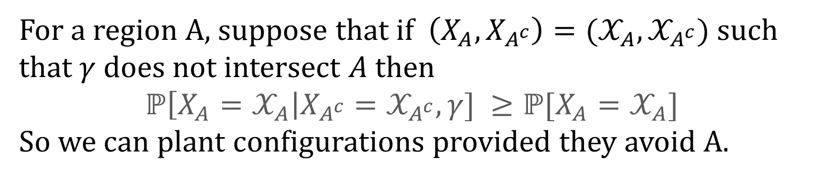
Planting a configuration
For a region A, suppose that if $\left(X_{A},X_{A^{c}}\right)=(𝒳_{A},𝒳_{A^{c}})$ such that $γ$ does not intersect $A$ then
$$ℙ\left[X_{A}=𝒳_{A}\right|X_{A^{c}}=𝒳_{A^{c}},γ] ≥ℙ[X_{A}=𝒳_{A}]$$
So we can plant configurations provided they avoid A.
A

Slide 21
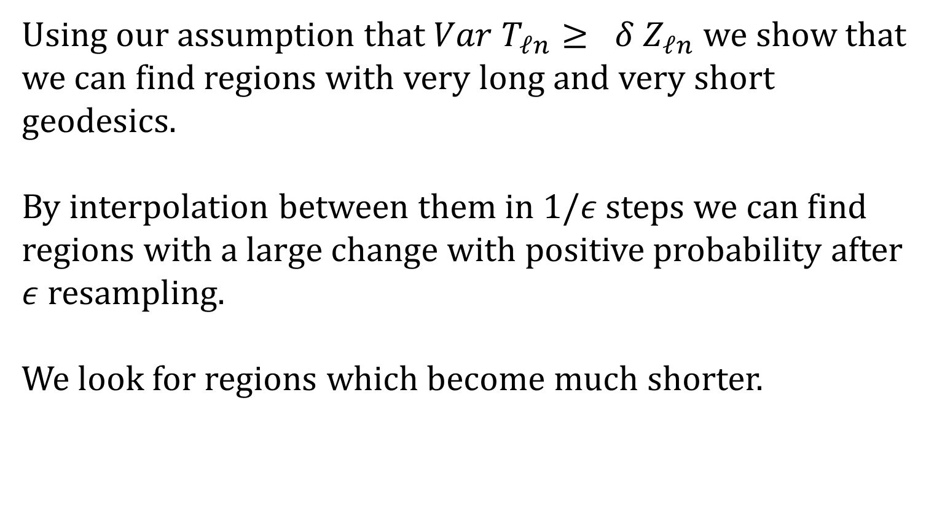
Big changes
Using our assumption that ${Var T}_{ℓn}≥ δ Z_{ℓn}$ we show that we can find regions with very long and very short geodesics.
By interpolation between them in $1/ε$ steps we can find regions with a large change with positive probability after $ε$ resampling.
We look for regions which become much shorter.

Slide 22
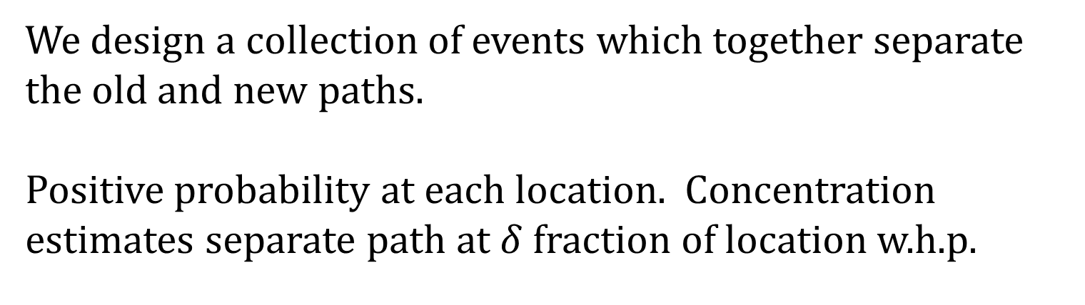
Pulling the paths apart
We design a collection of events which together separate the old and new paths.
Positive probability at each location. Concentration estimates separate path at $δ$ fraction of location w.h.p.

Slide 23
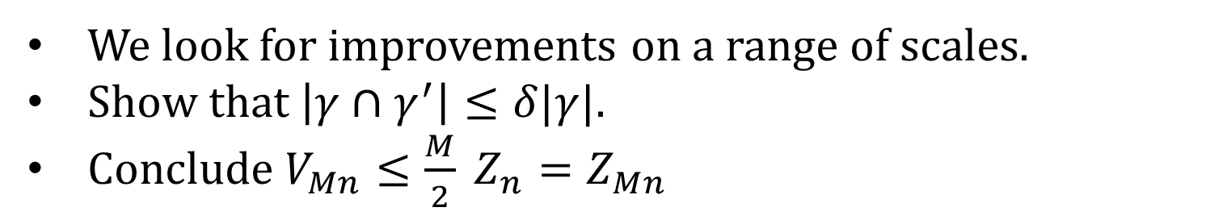
Multi-scale Improvements
We look for improvements on a range of scales.
Show that $\left|γ∩γ^{′}\right|≤δ|γ|$.
Conclude $V_{Mn}≤\frac{M}{2} Z_{n}=Z_{Mn}$

Slide 24
Lattice models
Can rotational invariance be relaxed?
Should be sufficient that the limiting shape is smooth and has positive curvature in a neighbourhood of the direction.

Slide 25
Thank you for listening

